Slide 1
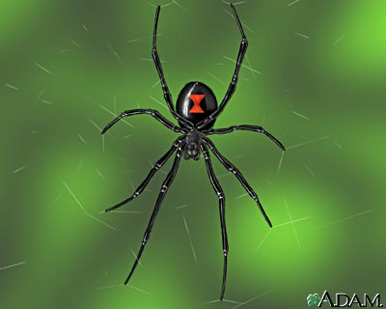
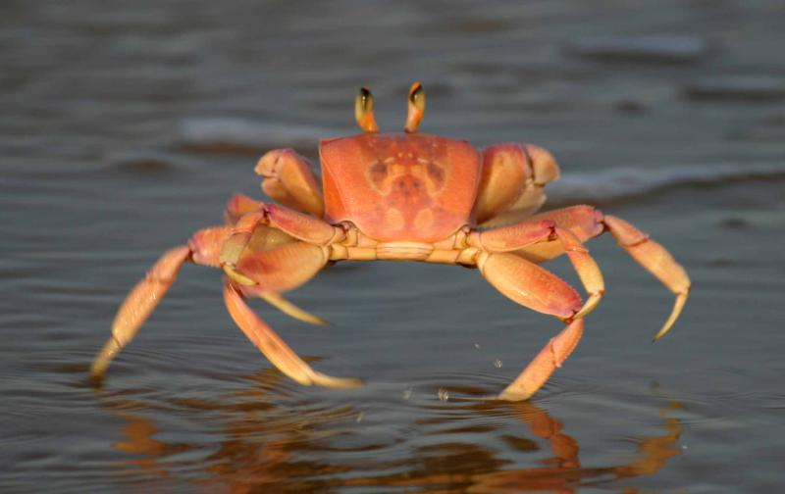
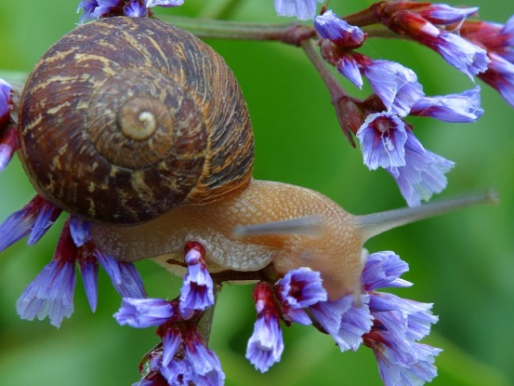
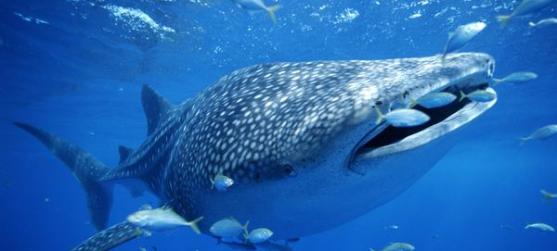
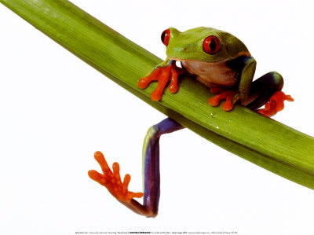
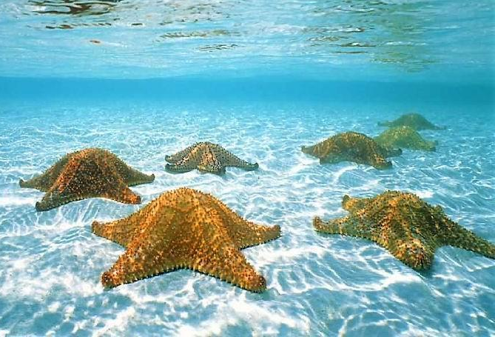
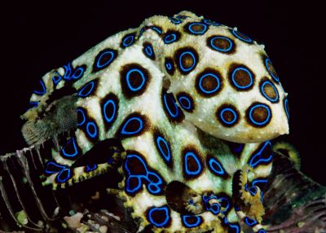
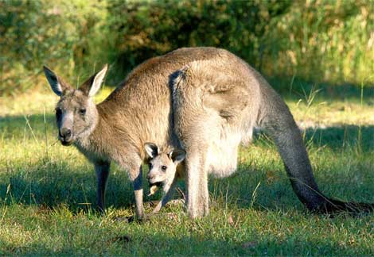
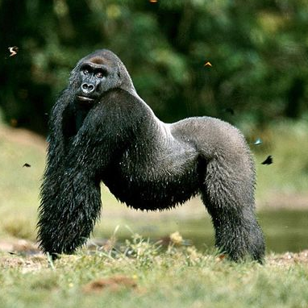
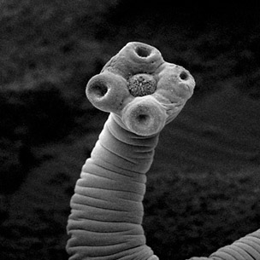
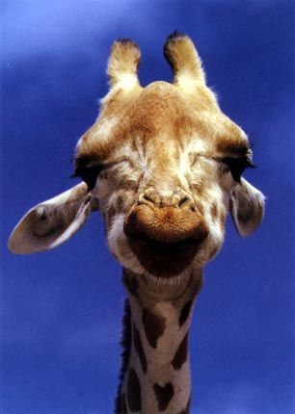
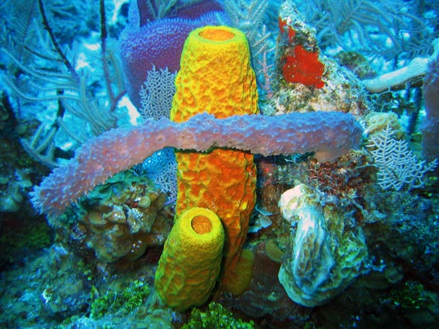
Zoology

Slide 2
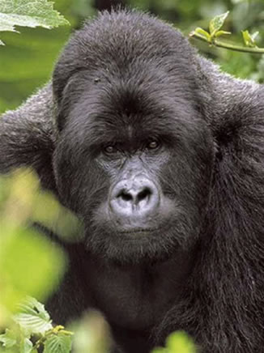
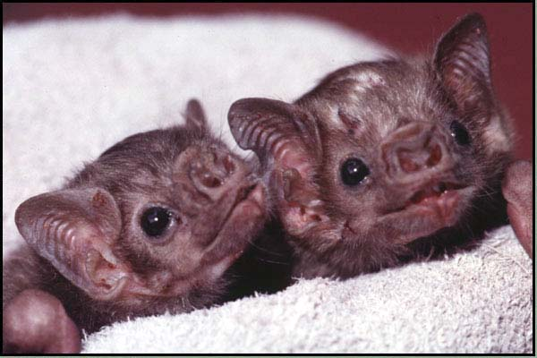
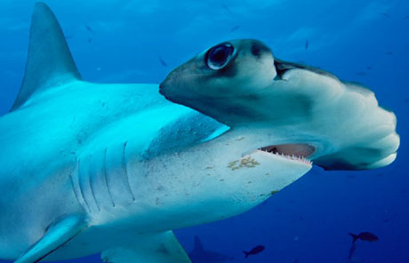
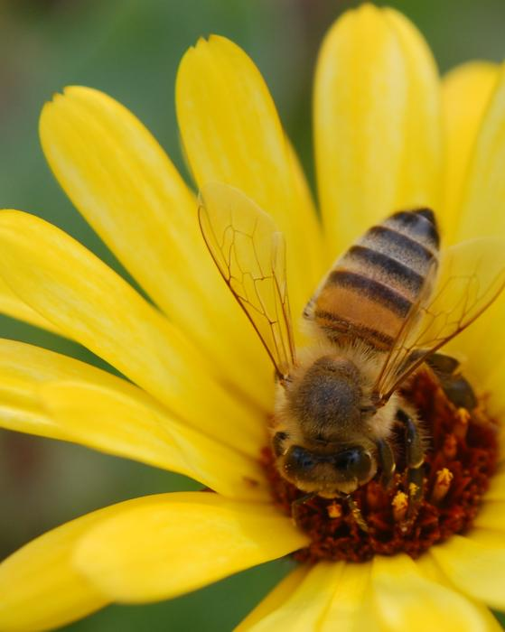
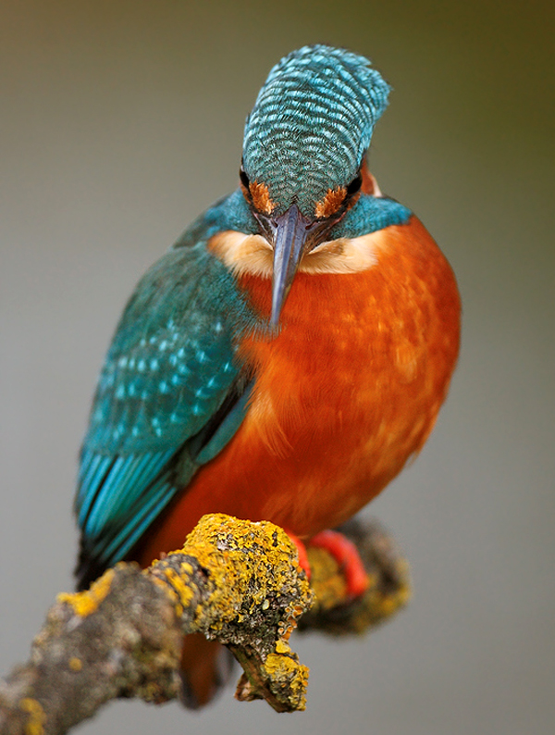
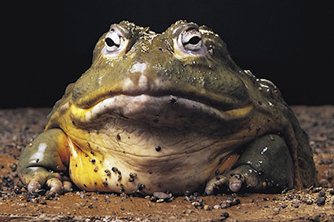
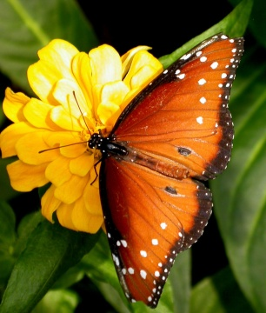
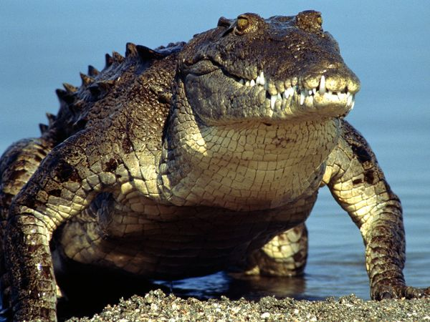
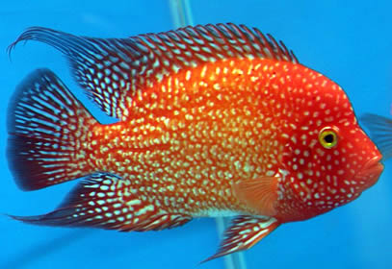
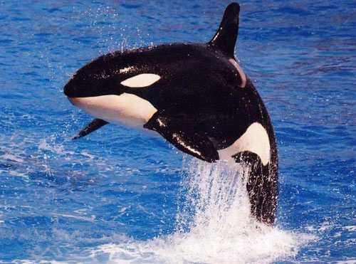
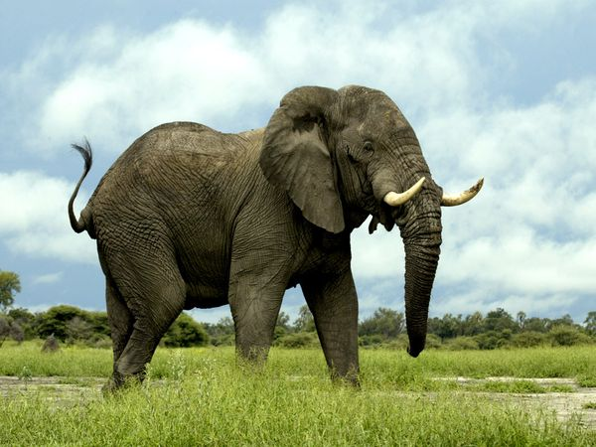
Zoology: The study of Animals
Entomology
Herpetology
Ichthyology
Mammalogy
Ornithology
Protozoology

Slide 3
Diversity
Evolution
  Change over time
  Theory to explain the unity and diversity of life
  Charles Darwin

Slide 4
Darwin’s Theory of Evolution
Variation occurs among members of a species
Competition for resources is due to overpopulation
Adaptation enables survival and reproduction
An increased proportion of individuals in succeeding generations have that adaptive characteristic
The result is a population adapted to its local environment

Slide 5
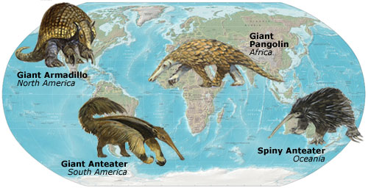
Darwin’s Evidence for Evolution
Fossil Record
Biogeography
Comparative Anatomy
  Homologous Structures
  Vestigial Structures
Embryological Development

Slide 6
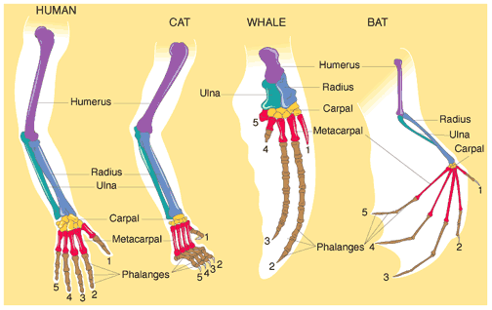
Comparative Anatomy
Homologous Structures
  Different mature forms, same embryonic tissues
Analogous Structures
  Convergent Evolution
  Unrelated organisms have similar structures to make successful use of a common environment.
Notes:
Embryology, vestigial structures

Slide 7
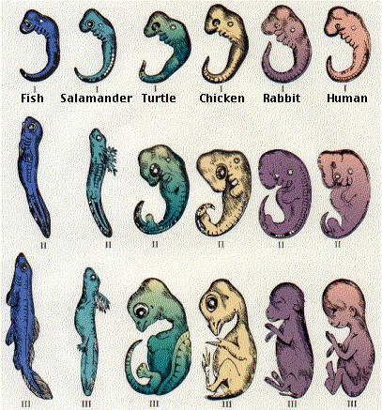
Embryological Development
Embryology
  Many vertebrates show similarities during early stages of development
  Changes are due to size/proportion of organs and growth rate
Notes:
Embryology, vestigial structures

Slide 8
Molecular Biology
Comparing the genomes of different groups of animals to see how closely related the genetic sequences are.
Growing steadily as the #1 evidence for evolution
  Whale’s closest living land relative
    Fossils: Even-toed hoofed mammals (cow, sheep, camels)
    Milk protein: Hippo
Notes:
Studying nuclear DNA, mitochondrial DNA, ribosomal RNA, and proteins…direct evidence of changes in genes…evolution

Slide 9
Evolution
Remember, individuals do not evolve…populations do.
Evolution is simply a result of some individuals in a population surviving and being more effective at reproducing than others in the population…leading to changes in the gene pool.
  Gene flow and mutations
Notes:
Biologists used to study relationships by looking at the morphology of organisms (structure)…now most of it is based on similarities in DNA and protein structure.

Slide 10
Systematics (taxonomy)
The study of the kinds and diversity of organisms and of the evolutionary relationships among them.
These studies result in the description of new species and the organization of animals into groups (taxa).
Notes:
When Zoologists classify animals into taxonomic groupings they are making hypotheses about the extent to which groups of animals share DNA, even when they study vaariations in traits like jaw structure, color patters, and behavior…because these kinds o ftraits ultimately are based on the genetic material.

Slide 11
Levels of Organization
Domain
Kingdom
Phylum
Class
Order
Family
Genus
Species
Each level is based on relatedness.
For example, organisms in the same species are more closely related than organisms that are in the same genus.
Notes:
When Zoologists classify animals into taxonomic groupings they are making hypotheses about the extent to which groups of animals share DNA, even when they study vaariations in traits like jaw structure, color patters, and behavior…because these kinds o ftraits ultimately are based on the genetic material.

Slide 12
Binomial Nomenclature
Two word naming system
First part
  Genus
  Always Capitalized
Second part
  Species
  Always lowercased
Name is underlined or italicized
Notes:
Common names

Slide 13
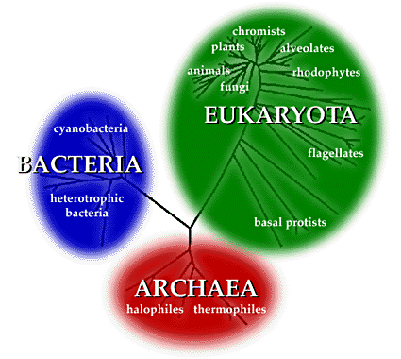
Domain
Ribosomal RNA studies elude to 3 major evolutionary lineages.
Each of these lineages is called a Domain.
Domains supersede Kingdoms as the broadest taxonomic grouping.
Notes:
When Zoologists classify animals into taxonomic groupings they are making hypotheses about the extent to which groups of animals share DNA, even when they study vaariations in traits like jaw structure, color patters, and behavior…because these kinds o ftraits ultimately are based on the genetic material.

Slide 14
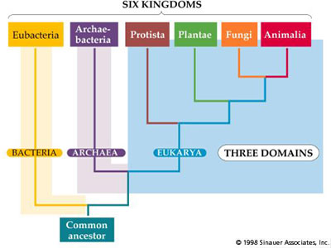

Slide 15
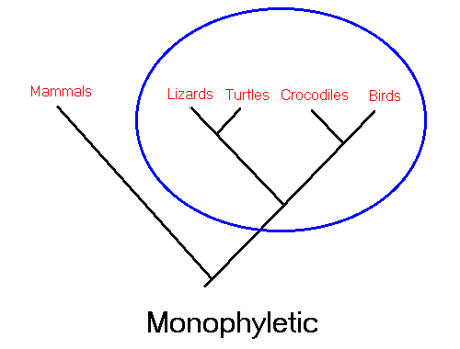
Animal Systematics
Goal: Arrange animals into groups that reflect evolutionary relationships
Ideally…they should include a single ancestral species and all of its descendants.
Monophyletic group
Notes:
A monophyletic grouping is one in which all species share a common ancestor and all species derived from that common ancestor are included. This is the only form of grouping accepted as valid by cladists. (For example, turtles, lizards, crocodilians and birds are all derived from a shared common ancestor. Thus a monophyletic grouping would place all of these together, rather than placing birds into a separate group.)

Slide 16
Animal Systematics
Evolutionary Systematics (physical characteristics)
  Assume that organisms closely related to an ancestor will resemble that ancestor more closely than they resemble distantly related organisms.
Phylogenetic Systematics (cladistics)
  Very similar to evolutionary systematics, but cladists use more “scientific” measures to show relationships.
Notes:
“scientific measures”….DNA, tests, experiments…not just homologs

Slide 17
Let’s learn some long words….
Symplesiomorphies: common characters that all members of a group have.
Outgroup: a group that shares an ancestral character, but does not share any of the new characters.
Derived characters (synapomorphies): characters that have arisen since common ancestry with the outgroup

Slide 18
Sample Cladogram
Outgroup
Individual Clade
5
4
3
2
1
F
E
G
H
D
C
B
A
Character A: Symplesiomorphy
Notes:
What single character is a synapomorphy for taxa 1 and 2 (separating them from all other taxa)??...C

Slide 19
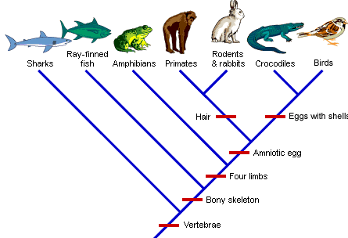

Slide 20
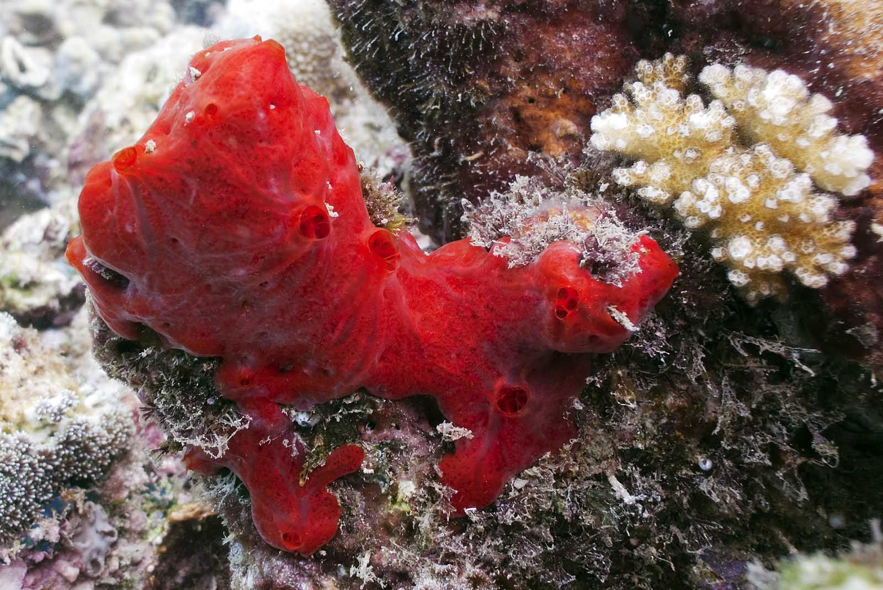
Patterns of Organization
Symmetry
Asymmetry: absence of a central point or axis around which body parts are equally distributed.
Ex:
Sponges

Slide 21
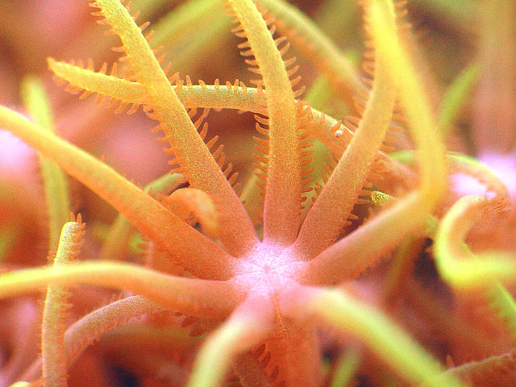
Patterns of Organization
Symmetry
Radial Symmetry
  Arrangement of body parts such that any plane passing through the central oral/aboral axis divides the animal into mirror images
  Paired arrangement of structures is called biradial symmetry

Slide 22
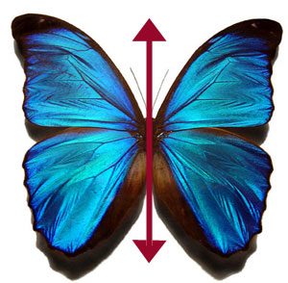
Patterns of Organization
Symmetry
Bilateral symmetry
  Arrangement of body parts such that a single plane divides the animal into left/right mirror images.
  Characteristic of swimming, crawling, or active animals.
  Complex sensory structures
  are usually at one end of the
  organism…resulting in the
  formation of a distinct
  head (cephalization)

Slide 23
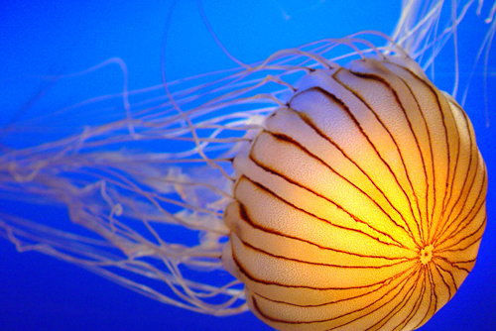
Patterns of Organization
Germ Layers
Diploblastic organization
  Tissue level of organization
  Body parts are organized from two embryonic tissue layers (endoderm and ectoderm)
  Ectoderm: gives rise to the epidermis
  Mesoglea: between each layer (no cells)
  Endoderm: gives rise to the gastrodermis
  Both are interdependent
  Cnidarians
Notes:
Epidermis: outer layer of the body wall….contains epithelial and muscular cells.
Gastrodermis: lines the gut cavity…contains nutritive (digestive) and muscular cells

Slide 24
Patterns of Organization
Germ Layers
Triploblastic Organization
  Tissues are derived from 3 germ layers
  Organ system level of organization
  Endoderm and Ectoderm
  Mesoderm (middle layer)
    Gives rise to supportive, contractile, and blood cells
  Organized into subgroups based on presence or absence of body cavity

Slide 25
Triploblastic
Body Cavities (COELOM)
Fluid filled space in which internal organs can be suspended and separated from the body wall.
  Provides more room for organ development
  Provides more surface area for diffusion
  Provides an area for storage
  Acts as a hydrostatic skeleton
  Vehicle for wastes and reproductive products
  Facilitates increased body size

Slide 26
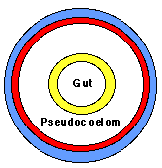
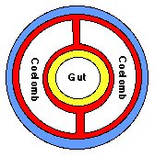
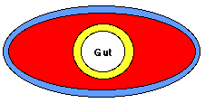
Acoelomate
  No fluid filled cavity, diffusion across membrane
Pseudocoelomate
  No membranes suspend organs in the cavity
Coelomate:
  Organs are attached to each other, suspended while moving freely in the cavity.

Slide 27
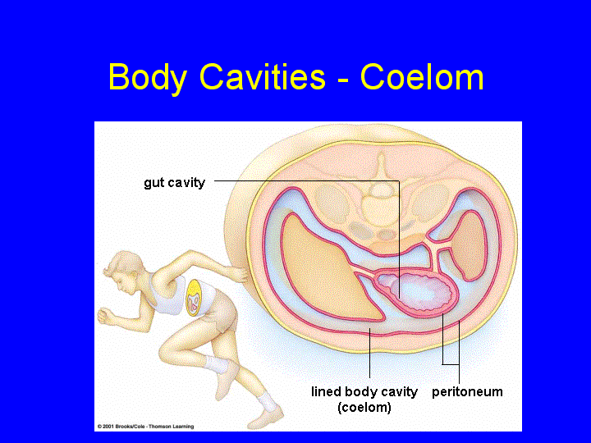

Slide 28
Cleavage Patterns and
Coelom Formation
Protosomes
  Platyhelminthes, Nematoda, Mollusca, Annelida and Arthropoda
  Mouth forms from an embyronic blastophore
  Trochophore larva
Deuterostome
  Echinoderms and Chordates
  Anus that forms from an embryonic blastophore
  No single kind of larval stage

Slide 29
Reproductive
Strategies

Slide 30
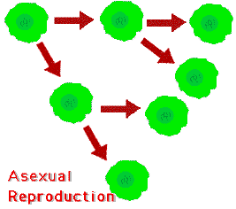
Asexual Reproduction
First 2 billion years
Advantages:
One parent (quick and easy)
Increase numbers quickly
Favorable in stable environment
Disadvantages:
Offspring identical (clones)
Slow evolution/ less diversity (extinction)

Slide 31
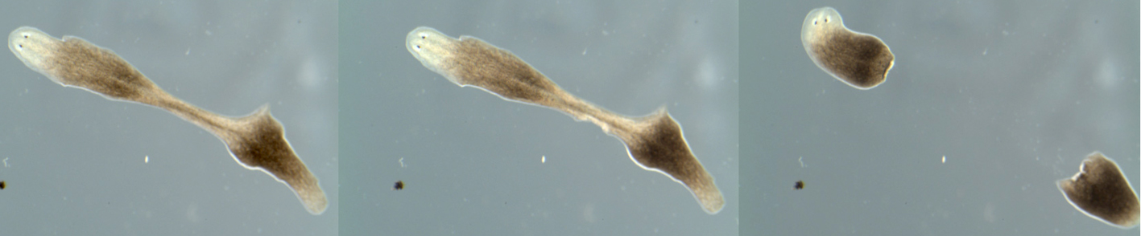
Fission
Division into two or more
Equal division is called binary fission
Can be along any plane

Slide 32
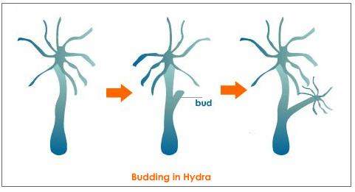
Budding
Group of cells on parent develops into new individual

Slide 33
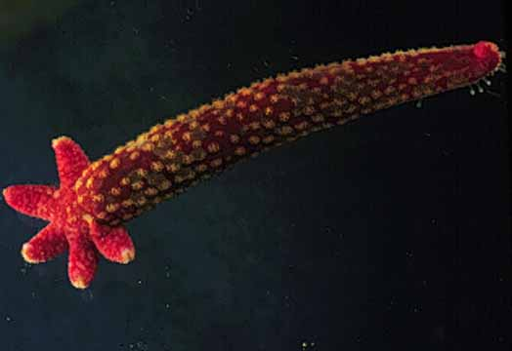
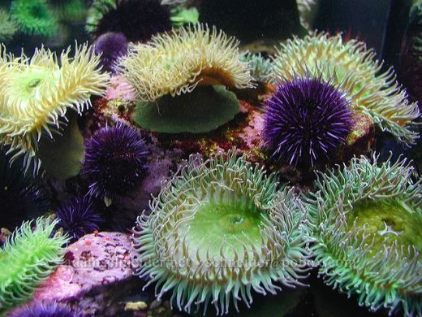
Fragmentation
A body part is lost and then regenerates into a new organism

Slide 34
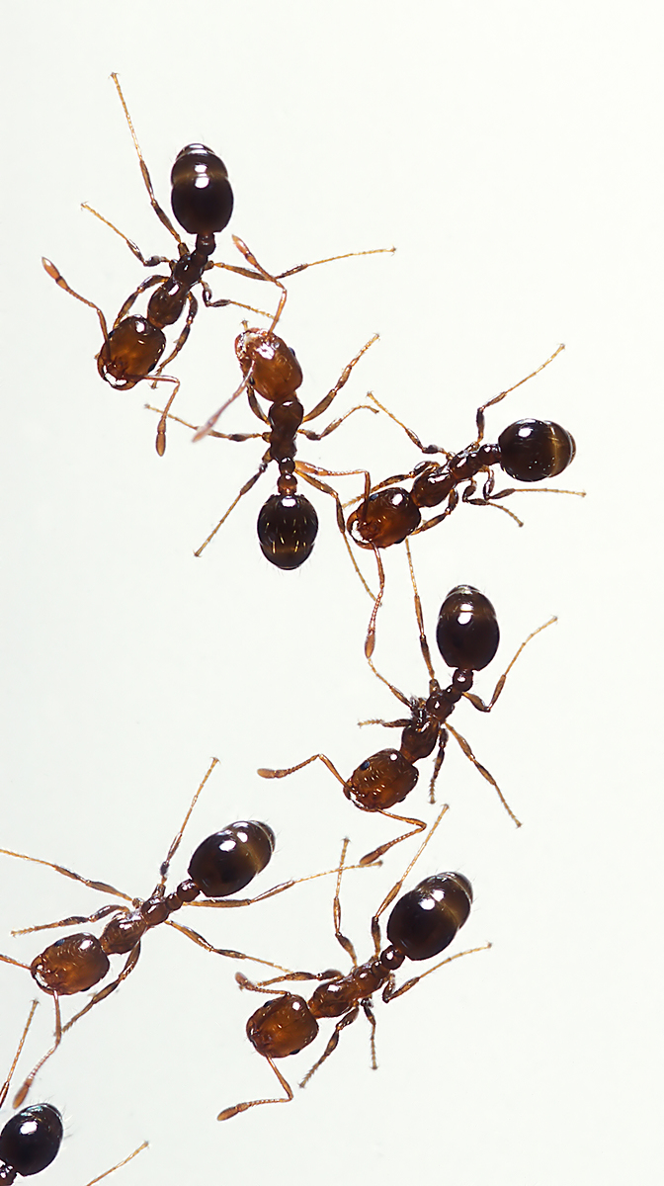
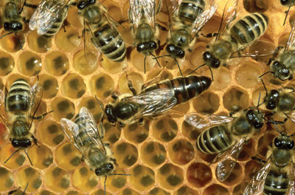
Parthenogenesis
“Virgin Birth”
Egg develops without fertilization
  Some diploid, some are haploid
Uncommon, but it does play an important role in social organisms

Slide 35
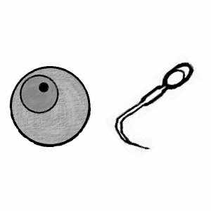
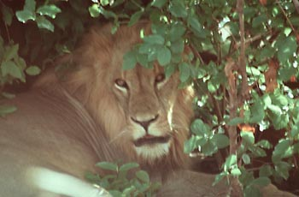
Sexual Reproduction
Gametes produced (sperm and ova)
Advantages:
Genetic diversity (withstand environmental pressure)
Disadvantages:
Complicated-- time, energy requirement
“Cost of meiosis”-- only half genes passed
Wastage in the production of males

Slide 36
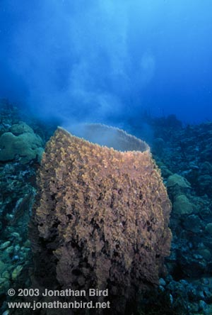
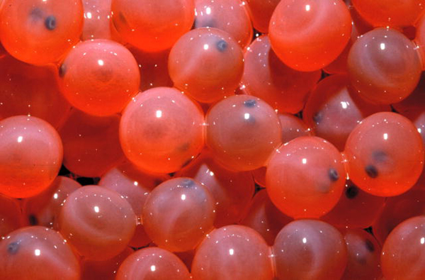
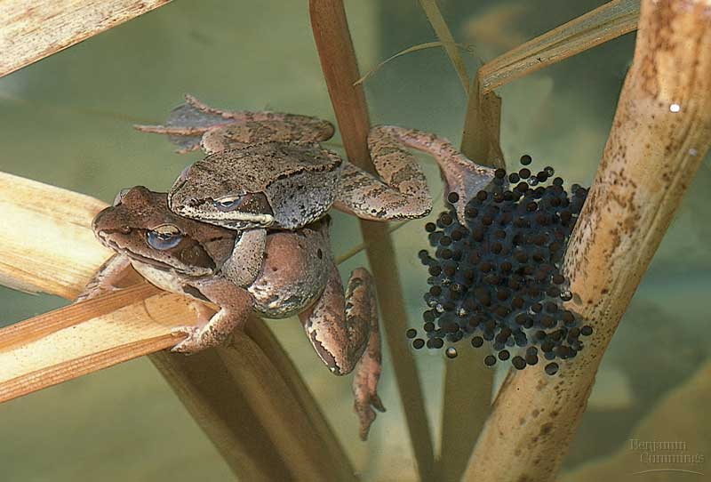

External Fertilization
Releasing gametes into the water

Slide 37




Internal Fertilization
Transfer of sperm from male to female
May use spermatophores

Slide 38



Monoecious
Hermaphroditic
Has both functional parts (male and female)
Most mate with other species…why?
Some are sequential
  Protogynous: female first
  Protandrous: male first
  Happens when sex ratio changes (oysters) or in schools of fish (if dominant male is killed and female can change sex)

Slide 39


Dioecious
Separate sexes

Slide 40




Oviparous
Egg layers
Offspring receive nourishment from the egg

Slide 41

Fish
External fertilization
Oviparous
Millions of eggs (so that a few survive)

Slide 42

Amphibians
External fertilization- usually require water
Most oviparous
Larval and adult stage

Slide 43

Reptiles
Internal fertilization
Oviparous-
  shelled egg (no water required)- first amniotic egg
Some ovoviviparous (boas) or viviparous (blue tongued skink)

Slide 44

Birds
Internal fertilization
Complex mating rituals (dimorphism)
Many monogamous
All oviparous- thicker shell
Brood or incubate eggs
Extensive parental care

Slide 45



Ovoviviparous
“Egg live birth”
Eggs held within body to hatch and born live

Slide 46




viviparous
“Live birth”
Fetus is nourished by female throughout gestation
Placental
Marsupial

Slide 47



Internal fertilization
Mammals
Monotreme: oviparous
Marsupial: viviparous
(immature young develop in pouch)
Placental: viviparous

Slide 48
What are we
going to study?

Slide 49

Sponges
Phylum Porifera
Cell level of organization
Filter feeders
Choanocytes

Slide 50



Phylum Cnidaria
Jellyfish, hydra, coral
Tissue level of organization
Body forms
  Medusa (free-swimming)
  Polyp (sessile)
Nematocysts

Slide 51



Flatworms, Roundworms, and Segmented worms
Very diverse
Many environments
Some are parasitic

Slide 52




Phylum Mollusca
Snails, squid, clams, octopuses
True coelom
Gastropods
  1 external shell
Bivalves
  2 external shells
Cephalopods
  Advanced
  Lost or reduced shell

Slide 53



Arthropods
Spiders, Crayfish, Insects
Bilateral Symmetry
Adaptations
  Jointed appendages
  Exoskeleton
  Segmented body

Slide 54



Echinoderms
Starfish, Sand dollars, sea urchins,
Radial Symmetry
Endoskeleton
Tube feet

Slide 55


Phylum Chordata
Notochord
Dorsal Nerve Cord
Post anal tail
Pharyngeal Gill Slits

Slide 56


Slide 57

Major vertebrate groups
Jawless fishes
Jawed animals
  Cartilaginous fishes
  Bony fishes
  Amphibian
  Reptiles
  Birds
  Mammals
Notes:
Copy and paste URL to link to original images at BIODIDAC
http://biodidac.bio.uottawa.ca/thumbnails/filedet.htm?File_name=cepl002b&File_type=GIF

Slide 58

Major vertebrate groups
Jawless fishes
Jawed animals
  Cartilaginous fishes
  Bony fishes
  Amphibians
  Reptiles
  Birds
  Mammals

Slide 59

Major vertebrate groups
Jawless fishes
Jawed animals
  Cartilaginous fishes
  Bony fishes
  Amphibians
  Reptiles
  Birds
  Mammals

Slide 60

Major vertebrate groups
Jawless fishes
Jawed animals
  Cartilaginous fishes
  Boney fishes
  Amphibians
  Reptiles
  Birds
  Mammals

Slide 61

Major vertebrate groups
Jawless fishes
Jawed animals
  Cartilaginous fishes
  Boney fishes
  Amphibians
  Reptiles
  Birds
  Mammals

Slide 62

Major vertebrate groups
Jawless fishes
Jawed animals
  Cartilaginous fishes
  Boney fishes
  Amphibians
  Reptiles
  Birds
  Mammals

Slide 63

Major vertebrate groups
Jawless fishes
Jawed animals
  Cartilagenous fishes
  Boney fishes
  Amphibians
  Reptiles
  Birds
  Mammals

