Slide 1
Survey of ECOLOGY!

Slide 2
What is Ecology?
Ecology is the scientific study of interactions among organisms and between organisms and their environment.

Slide 3
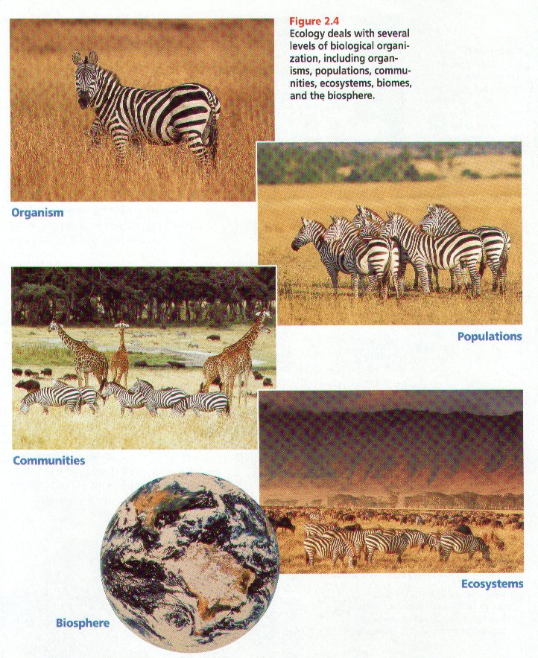

Slide 4
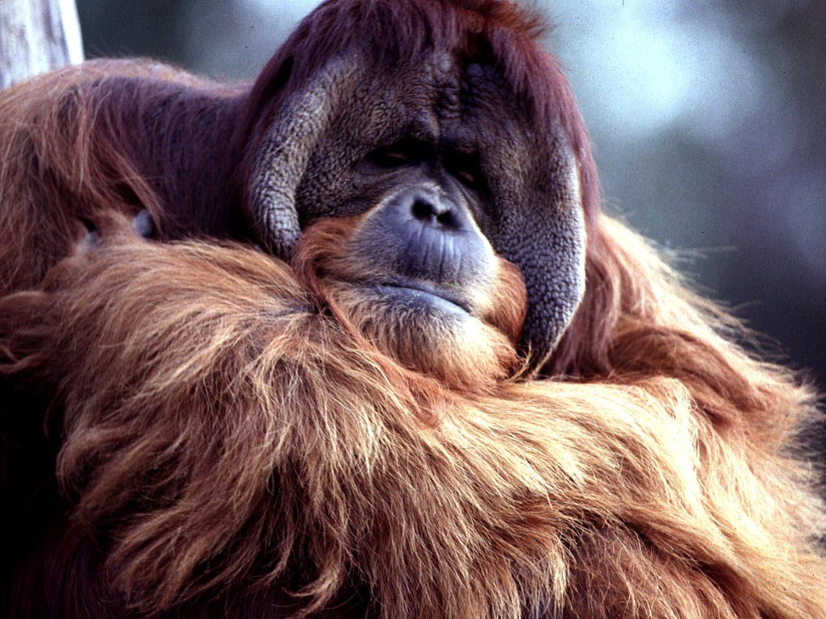
Organism
An individual living thing

Slide 5
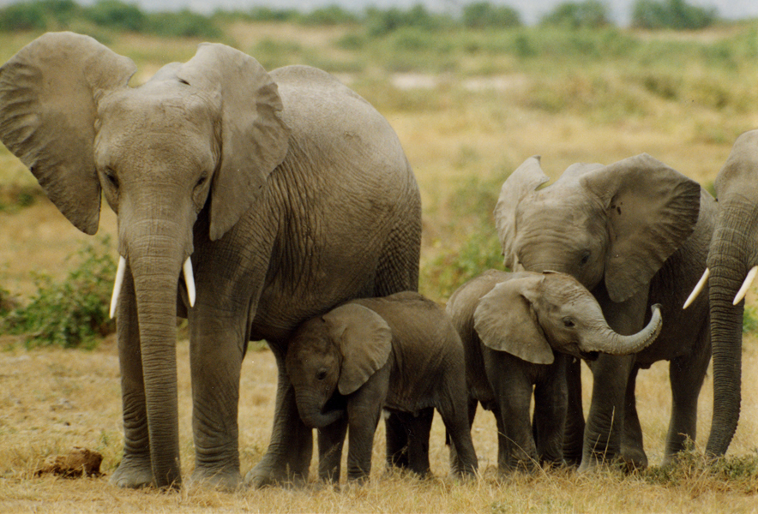
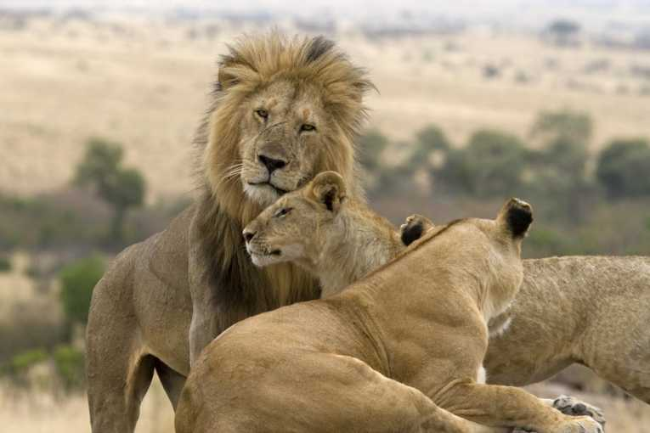
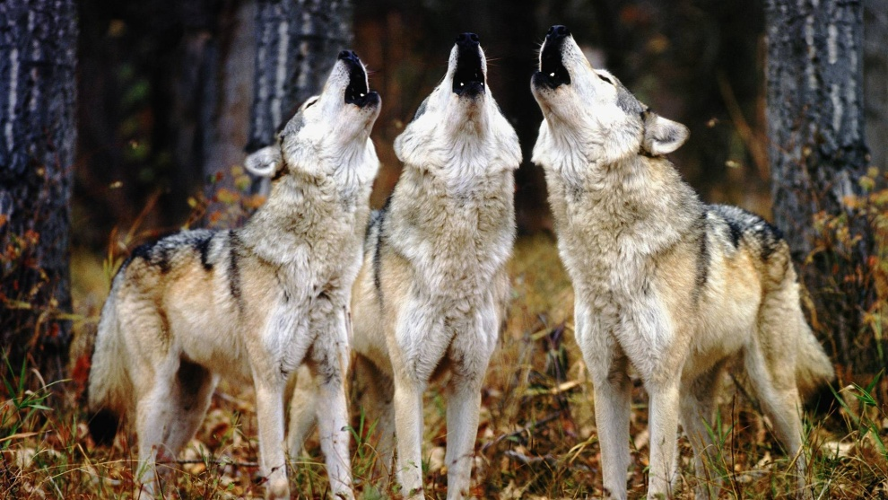
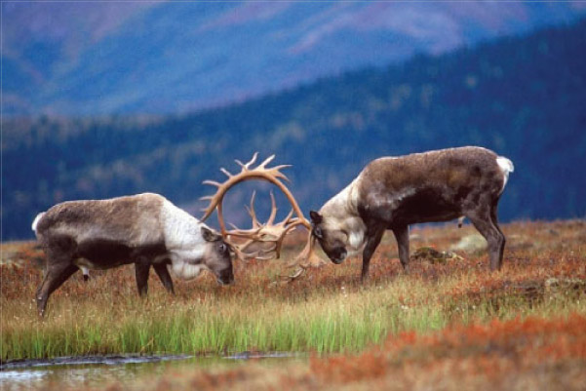
Population
Members of one species that interbreed and live in the same place at the same time.

Slide 6
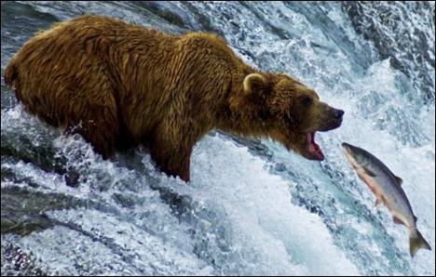
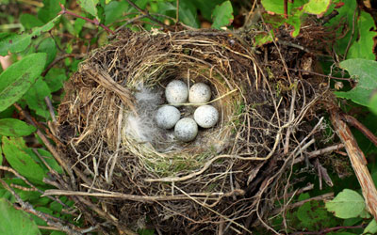
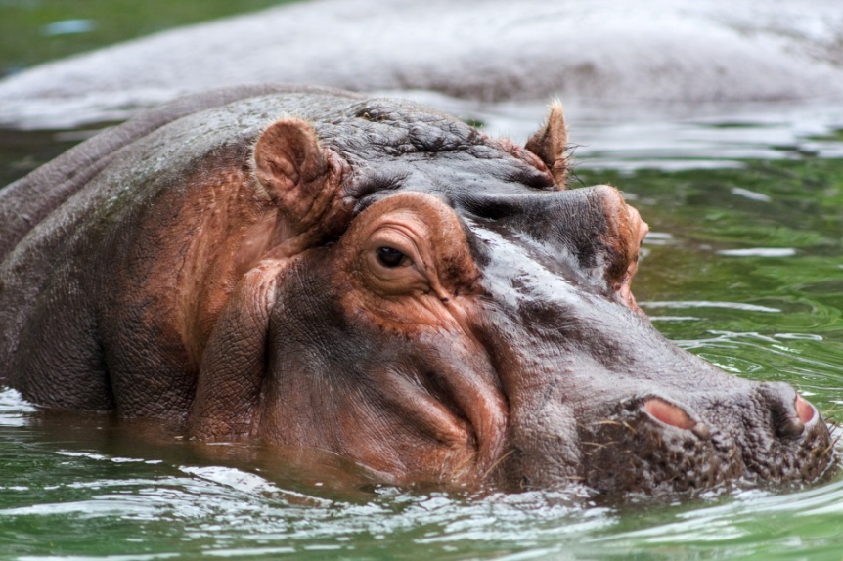
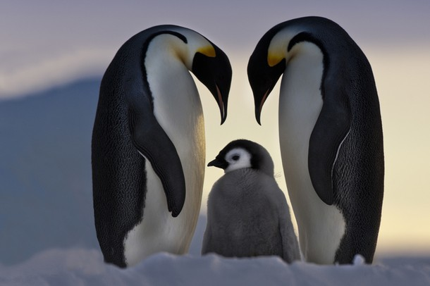
Population
Compete for:
  Food
  Water
  Shelter
  Mates

Slide 7
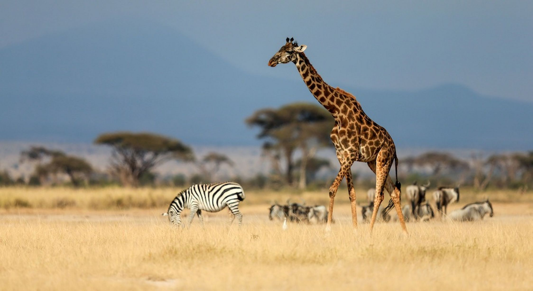
Community
Different populations that live together in a defined area.
Several populations interacting together.

Slide 8
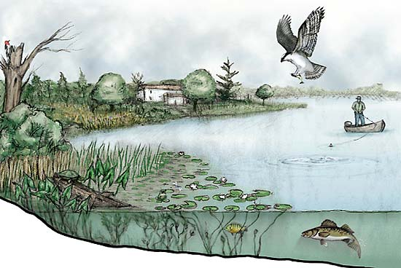
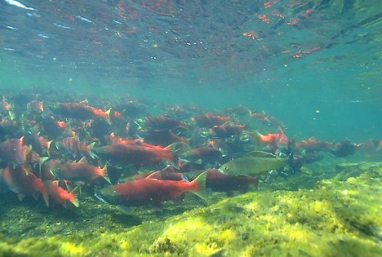
Ecosystem
A collection of all of the organisms that live in a particular place, together with their nonliving, or physical environment.

Slide 9
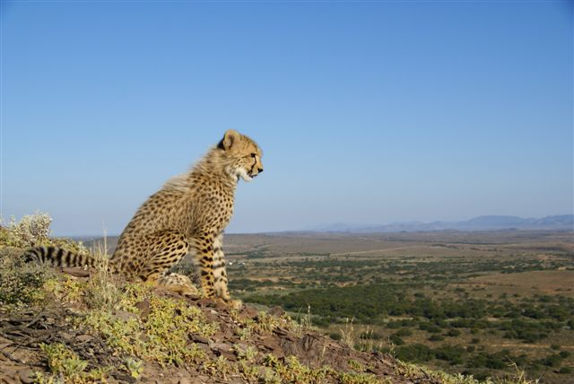
Ecosystem
Biotic Factors: living organisms within an ecosystem
Abiotic Factors: nonliving factors that help shape an ecosystem

Slide 10
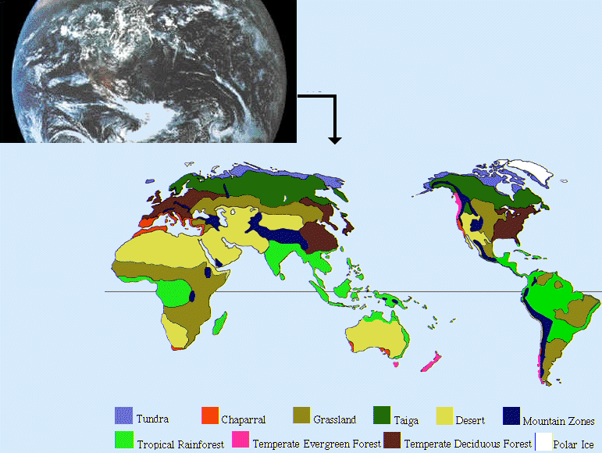
Biomes
A group of ecosystems that have the same climate and similar dominant communities.

Slide 11

Biosphere
The highest level of organization that ecologists study is the entire biosphere itself.
The portion of
the Earth that
supports life.

Slide 12

Energy Flow
All living things need ENERGY to survive.
Where does this energy ultimately come from?

Slide 13
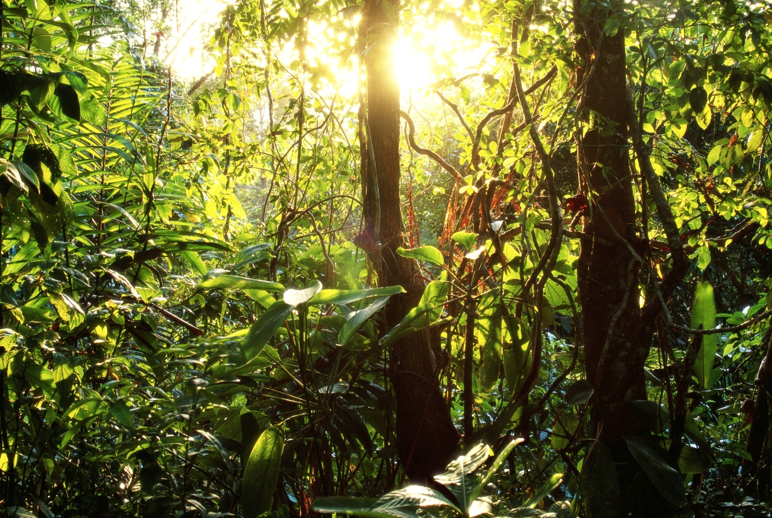
Autotrophs
Organisms that capture energy from sunlight or chemicals and use that energy to produce food.
Ex. Bacteria,
plants, and algae
Also called producers

Slide 14
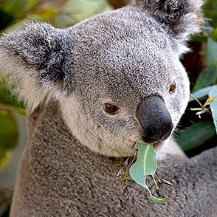
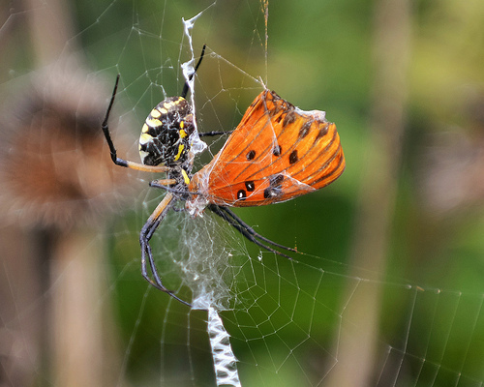
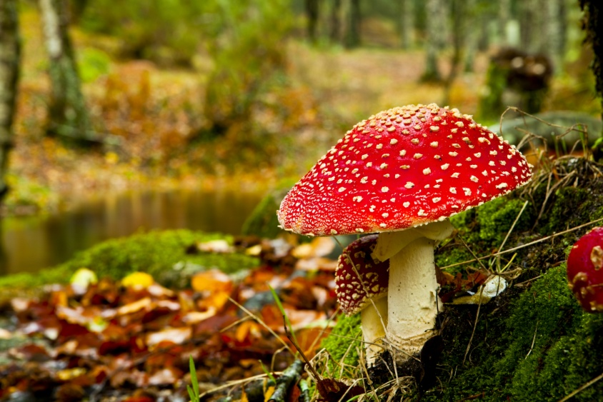
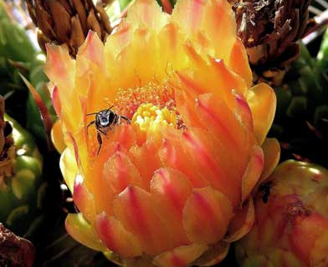
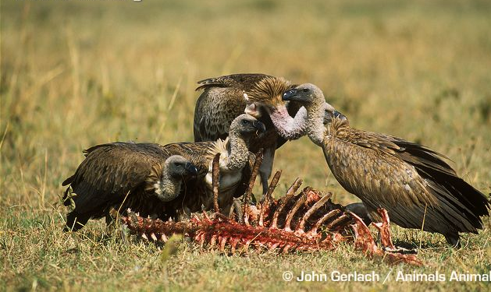
Heterotrophs
Rely on other organisms for
their energy and food supply
Also called consumers

Slide 15
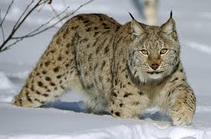
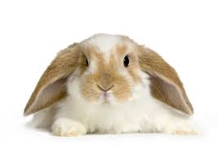
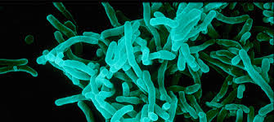
Types of Consumers
Herbivores
Carnivores
Omnivores
Detritivores
Decomposers

Slide 16
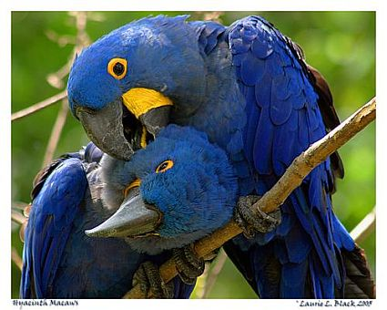
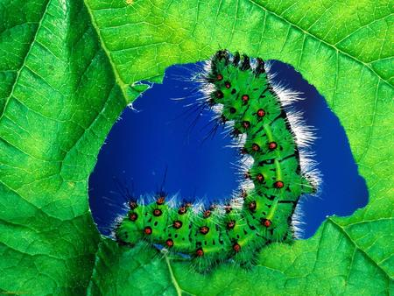
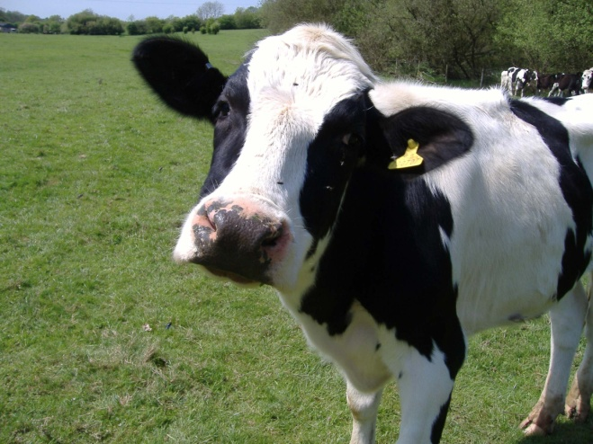
Herbivores: (1st order consumers)
Heterotrophs that eat plant leaves, roots, seeds or fruits.
The type of food that an herbivore can eat depends on the organism’s digestive system.
Ex: Cows, caterpillars, deer, and rabbits.

Slide 17
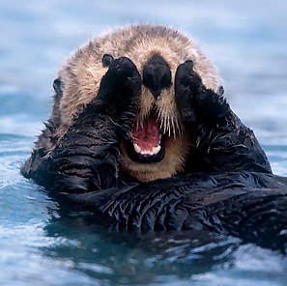
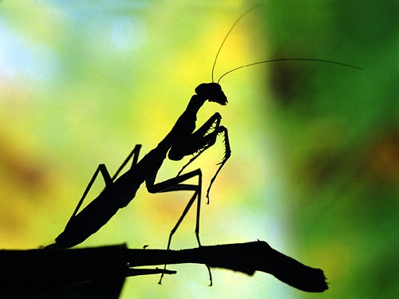
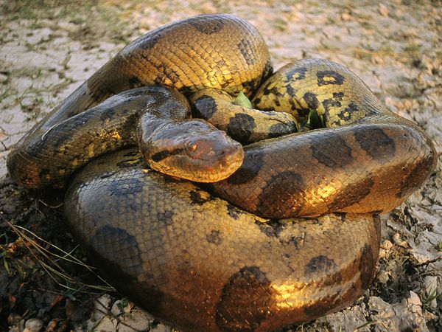
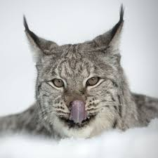
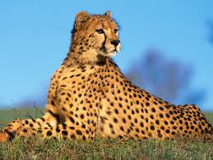
Carnivores
Heterotrophs that eat animals
Requires energy, but meat is rich in nutrients!
Ex: Snakes, dogs, cats, and otters

Slide 18
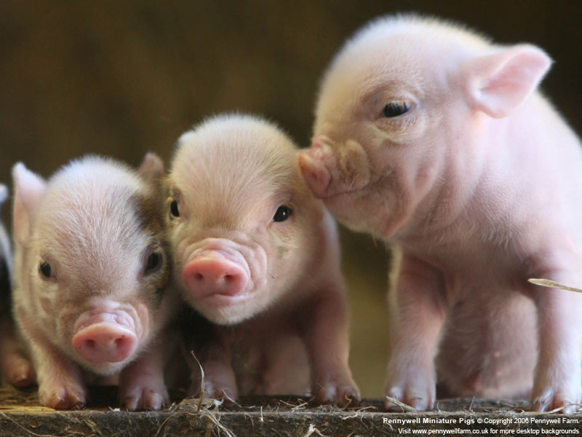
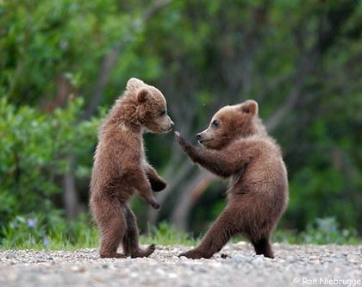
Omnivores
Eat both plants and animals
Ex: humans, bears, and pigs

Slide 19
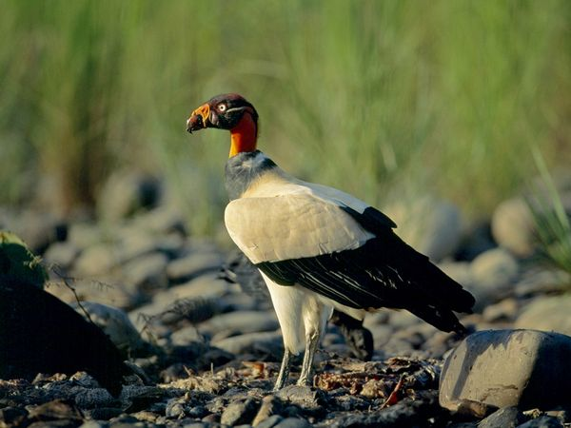
Scavengers
Consume the carcasses of other animals that have been killed by predators or have died of other causes.
Ex: Vultures

Slide 20
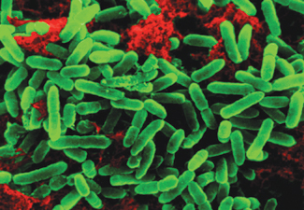
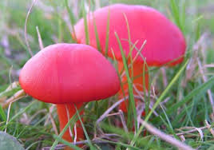
Decomposers
Break down decaying matter
Produces detritus
Ex: Bacteria and Fungi

Slide 21
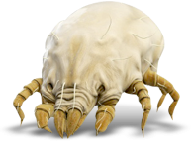
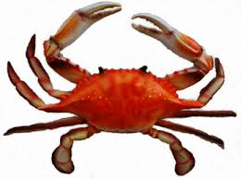
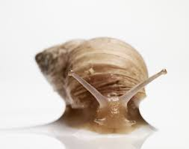
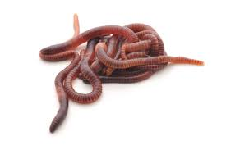
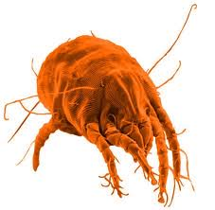
Detritivores
Animals that feed on animal remains and dead matter (collectively called detritus)
Ex: mites, earthworms, snails and crabs

Slide 22
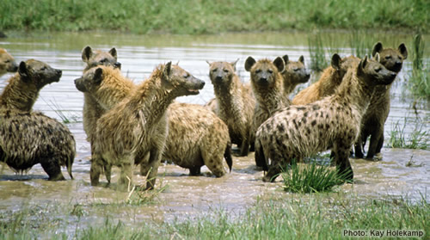
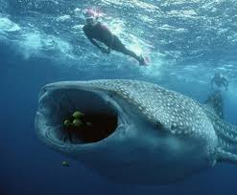
Not all organisms stay in one “consumer” category.
Examples:
  Hyenas may scavenge if they get the chance.
  Aquatic animals eat a mixture of detritus, algae, and bits of animal carcasses

Slide 23
Feeding Relationships
What happens to the energy in an ecosystem when one organism eats another?
  The energy moves along a one-way path.
Energy flows through an ecosystem in one direction, from the sun to autotrophs and then to various heterotrophs

Slide 24
Food Chains
The energy stored by producers can be passed through an ecosystem along a food chain, a series of steps in which organisms transfer energy by eating and being eaten.

Slide 25


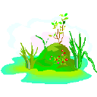

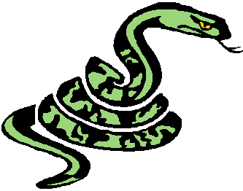
Each organism represents a trophic level, a step in the food chain.
Natural Food Chain
Sun Grass Rabbit Snake Hawk
The arrows show the direction that energy is transferred
Notes:
25

Slide 26
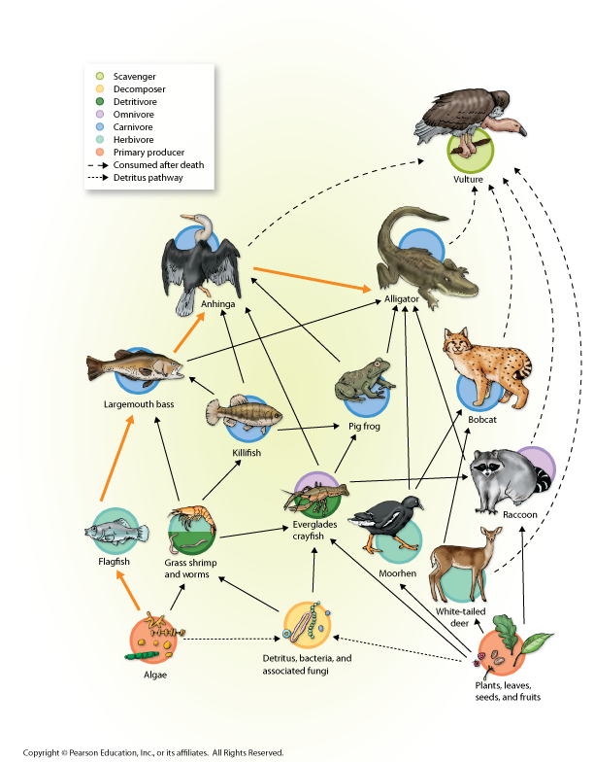
Food Webs
A network of feeding interactions.
Food webs show multiple food chains in an environment.

Slide 27
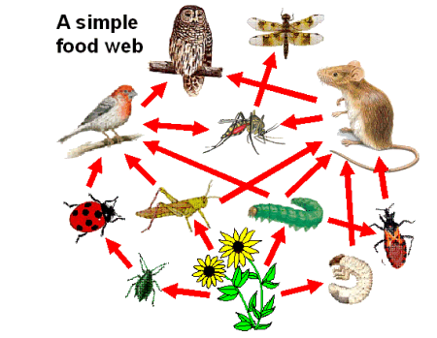
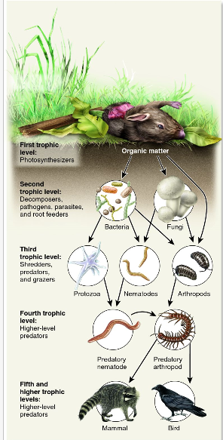
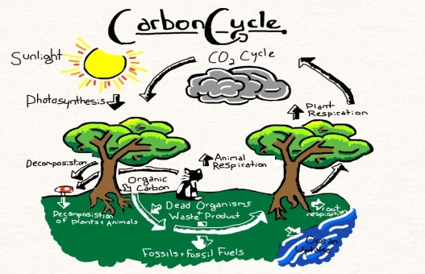
Decomposers and Detritivores in the Food Web
Decomposers “unlock” nutrients for other organisms to use.
  Convert dead material to detritus.
  Return important nutrients to the soil for primary producers to use.

Slide 28
Matter also is cycled throughout an ecosystem...
Water
Carbon
Nitrogen

Slide 29
Nutrient Cycles
Nutrients
  Chemical substances that an organism needs to sustain life.
  Organisms need nutrients to build tissues.
Oxygen, Carbon, Nitrogen and Phosphorus are all elements that are critical for life.

Slide 30
Carbon Cycle
Carbon is an essential component of proteins, lipids, nucleic acids, and carbohydrates .These are all organic compounds that all living things have…super important!
Four processes
  Respiration (adds)
  Combustion (adds)
  Decomposition (adds)
  Photosynthesis (removes)

Slide 31

Carbon Cycle

Slide 32
Nitrogen Cycle
All organisms require nitrogen to make amino acids which are essential building blocks of ________!
Nitrogen is also required to make nucleic acids such as DNA and RNA!
Nitrogen gas makes up 78% of the atmosphere…but only certain types of bacteria can use it.

Slide 33


Nitrogen Cycle
Nitrogen fixation
  Bacteria use the nitrogen in the atmosphere convert it into a form that plants can use.
  Consumers eat the plants and use that nitrogen to make their own proteins.
Decomposers also release
nitrogen back into the soil for
plants to use.
Humans use nitrogen gas to
make fertilizers.

Slide 34


Slide 35
What Shapes an Ecosystem?
Biotic and Abiotic Factors
Niche
  The full range of physical and biological conditions in which an organism lives and the way in which the organism uses those conditions.
Community Interactions
Ecological Succession

Slide 36
Ecosystem Terms
Habitat
  The area where an organism lives (its “address”) within an ecosystem
Niche
  The function or position of an organism within an ecological community (its “occupation”)
An organism’s niche includes:
  Feeding relationships
  Space and temperature requirements
  Impact on environment
Both include biotic and abiotic factors

Slide 37

Lynx Primary Habitat
Notes:
37

Slide 38

Niche of the Lynx
With their long legs and large furry paws, lynx are built for hunting in deep snow.
Their main food source is the snowshoe hare, but they are also known to take rodents, birds and fish.
Notes:
38

Slide 39

Lynx are cautious and secretive, and will avoid large open areas. They need a mosaic of stand types to den and find prey, but also need unbroken forest to provide stalking and security cover. Even when hunting, lynx prefer some cover and they typically won't cross openings more than 300 feet across.
Notes:
39

Slide 40

Types of Community Interactions
Competition
Predation
Symbiosis
  Parasitism
  Commensalism
  Mutualism
Notes:
40

Slide 41


Competition
  COMPETITION is a relationship in which different individuals or populations attempt to use the same limited resource.
  A resource refers to any necessity of life, such as
    Water
    Nutrients
    Light
    Food
    Space

Slide 42

Predation
  An interaction in which one organism captures and feeds on another organism
  Organism that does the killing-PREDATOR!!!!!!!!!!
  Organism that is the food is the PREY
Examples: snakes eating mice, bats eating insects, whales consuming krill.
Why are adaptations (like mimicry or camouflage) useful in this type of species interactions?

Slide 43


Slide 44

Symbiosis
Symbiosis- when two organisms live in close association
3 main interactions
  Parasitism
  Mutualism
  Commensalism

Slide 45



Parasitism
A relationship where one species (the parasite) benefits from the other species (the host) and usually harms it.
Difference between a parasite and a predator:
  Parasite spends some of its life in or on host
  Parasites don’t usually kill
  their host

Slide 46

Mutualism
A close relationship between two species in which each species provides a benefit to the other.
Bacteria/digestive
system

Slide 47


Commensalism
A relationship in which one species benefits and the other species is neither harmed nor helped.
Remoras/sharks
Birds nesting in trees

Slide 48



Ecological Succession
Ecosystems and communities are always changing
  Natural disturbances
  Human disturbances
  Populations change due to death, migration
Ecological Succession:
  Series of predictable changes in a community over time
Kudzu

Slide 49

Harvesting, Hunting,
and Poaching
Excessive harvesting and hunting can lead to extinction. (pets, houseplants, wood, food, or medicine)
Laws are put into place to
regulate hunting, fishing,
harvesting, and trade of wildlife.
If these laws are broken, then it is
considered poaching.

Slide 50



Invasive Exotic Species
An exotic species is a species that is not native to a particular region.
Exotic species can threaten native species that have no natural defenses against them.

Slide 51



Pollution
Pesticides, cleaning agents, drugs, and other chemicals are making their way into food webs around the globe.
Ex. DDT/bald eagle

Slide 52



Climate Changes
Organisms are well-adapted to their environments and have specific tolerance ranges to temperatures and abiotic conditions.
If an organism’s environment becomes unsuitable, then they may be forced to find another habitat or risk dying.

Slide 53


Why save them?

