Slide 1
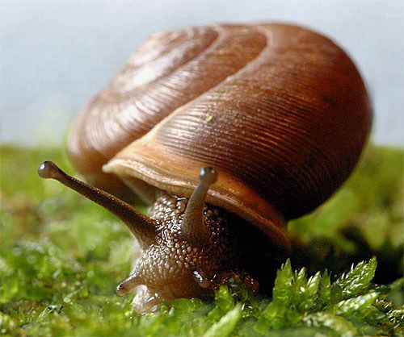
Phylum Mollusca
100,000 species
Name means “soft body”
Marine, freshwater and on land
Range from 5 mm to 20+meters
Many are protected by one or more shells

Slide 2
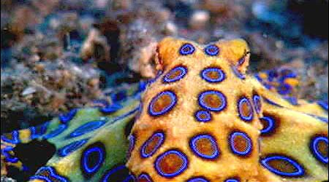
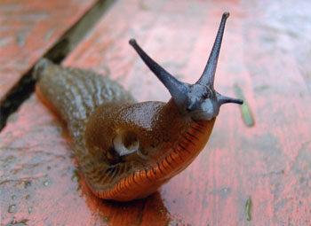
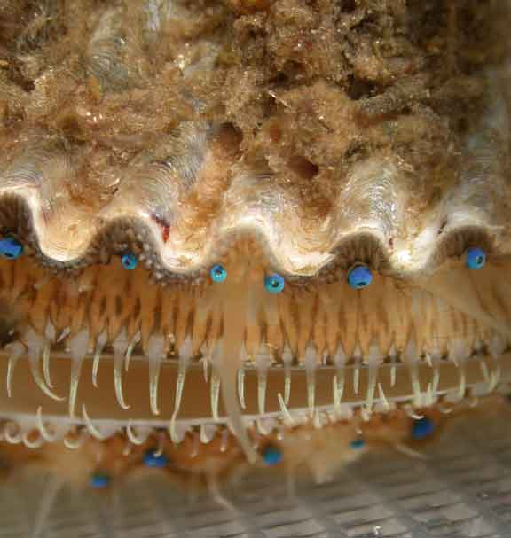
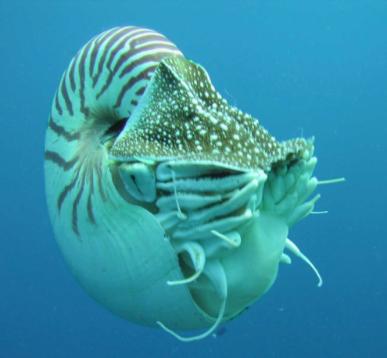
Characteristics
Closely related to annelids
Triploblastic
Bilateral symmetry
True cephalization
Coelomates
Organs can move, grow, and develop independently of the body wall while fluid cushions and protects them from shock.
In mollusks, mainly surrounding heart and gonads.

Slide 3
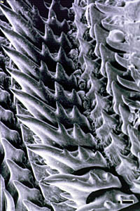
Characteristics
Two or three distinct body parts
Head-foot
Head: contains the mouth and sensory organs. Some have a radula (toothed organ to scrape food)
Foot: muscular for burrowing or modified into tentacles.
Visceral Mass
Opens to the outside
Functions in gas exchange, excretion, elimination of digestive wastes, and release of reproductive products
Mantle
Encloses all body organs (heart, stomach, gills)
Secretes shell
RADULA

Slide 4
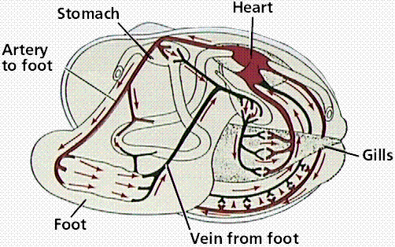
Characteristics
Open circulatory system (except in the cephalopods)
Blood vessels acts as pumps and release blood into open sinuses to “bathe” organs for gas exchange

Slide 5
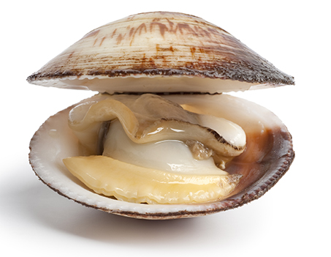
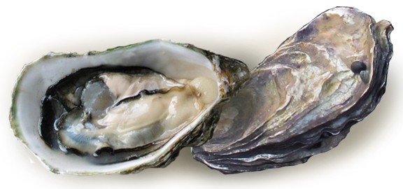
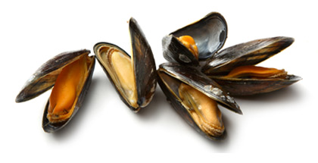
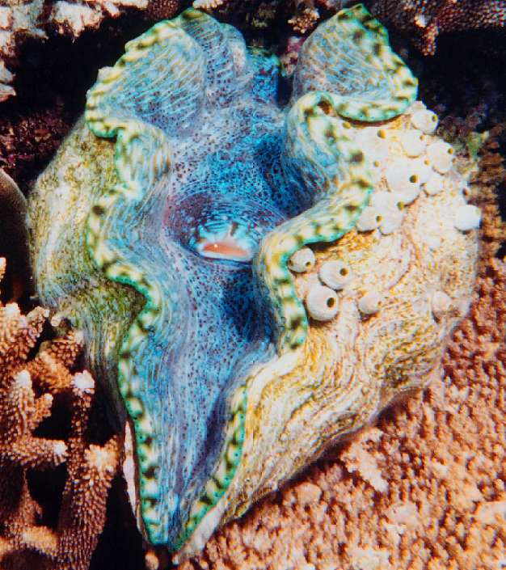
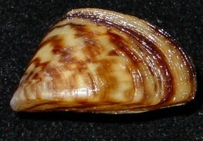
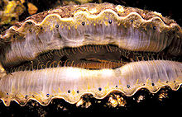
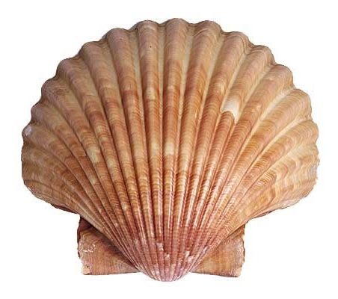
Class Bivalvia
“Hatchet Foot”
Two shells
Clams, oysters, mussels, and scallops
Aquatic habitats

Slide 6
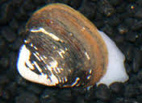
Clams
Most saltwater
May completely or partially burrow in sand/mud or attach to a substrate
Shell is secreted by the mantle in rings
Held together by ligaments
Two powerful adductor muscles close the shells
Defense against predators (mainly starfish)
Oldest part of the shell is called the umbo (swollen area)

Slide 8
Adaptations to a sedentary lifestyle
Filter-feeders
Filter pollutants out of the water
Mucus on gills trap food matter
No head or radula
Sensory organs are poorly developed
Light and touch only
Ganglia in foot and above mouth
Gas exchange via diffusion

Slide 9
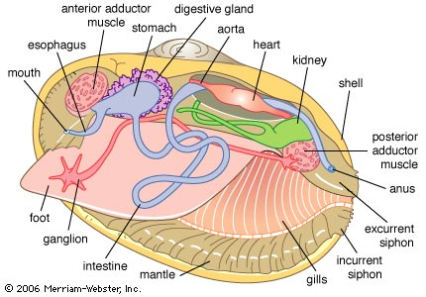

Slide 10
Reproduction
Separate sexes (Dioecious)
External fertilization
Eggs and sperm are shed into the water
Usually in the spring when the water starts to warm up
Females can release 100,000 to millions of eggs at a time
Trochophore larvae→Veliger larvae→ Adult clam (sedentary)

Slide 11
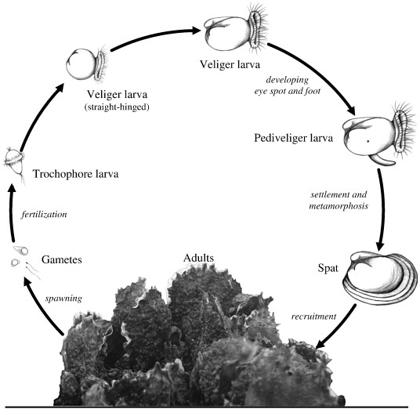

Slide 12
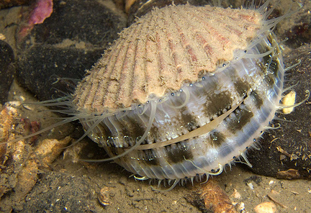
Scallops
Marine environments
Fan-shaped shell
Tentacles and eyes rim the mantle
Eyes (up to 100) sense movement
Open and close shell to move

Slide 13
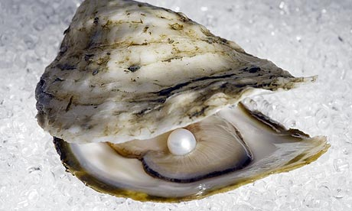
Oysters
Cannot move (attach to surfaces)
Harvested for pearls
Sand/grain/parasite lodges between the shell and mantle.
Mantle secretes nacre
around the irritant,
forming a
pearl

Slide 14
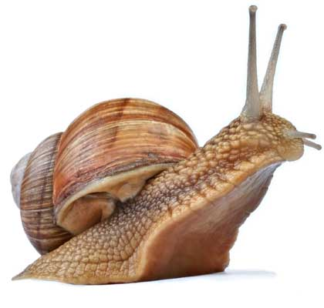
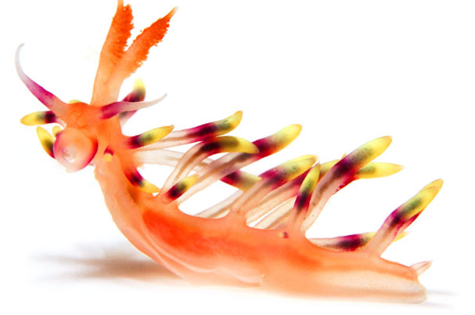
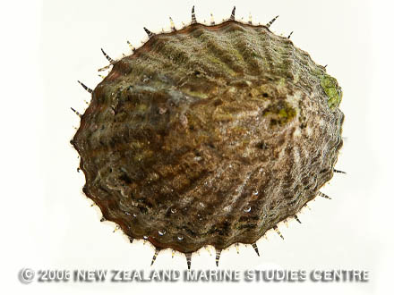
Class Gastropoda
“belly footed”
37,500 species
Snails, limpets, and slugs
Marine, freshwater, and terrestrial
Most are herbivores
Open circulatory system

Slide 15
Characteristics
Torsion
180 degree twisting the body so that the head enters the shell first, then gills, then anus
Protection for predators
Operculum (lid) closes off shell
Hydraulic skeleton
Increase blood flow to extend body (antennae)
Sensory structures
Eyes at tips of tentacles (can be photoreceptors or lens/cornea

Slide 16
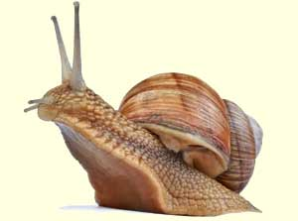
Snails
Most are less than 6 cm long
Aquatic environments
Breathe through gills
Terrestrial environments
Diffusion of gases through the mantle
Move by contracting the foot and gliding over a trail of mucus (gland cells)
Use radula to scrape plants

Slide 17
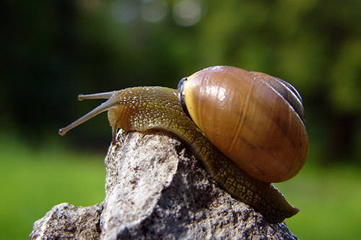
Snails
Excretion
Nephridia (only 1)
Reabsorbs ions and organic molecules
Aquatic snails: excrete ammonia (diluted in water)
Terrestrial: ammonia converted to uric acid (semi-solid to conserve water)

Slide 18
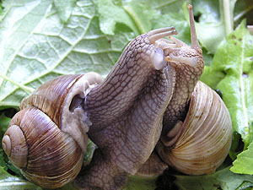
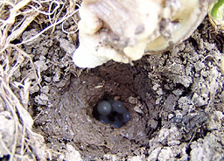
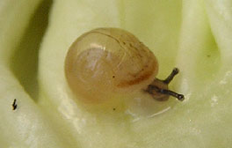
Reproduction
Monoecious (hermaphrodites)
Mutual sperm exchange will take place (internal fertilization)
Fertilized eggs will be placed beside a rock (aquatic) or be buried (terrestrial).
Hatchlings will have to find immediate sources of calcium to harden their shells (other eggs or hatchlings)

Slide 19
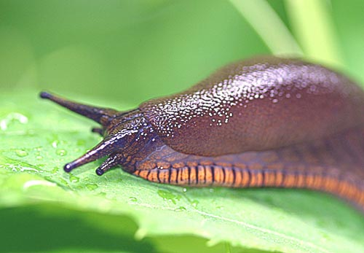
Slugs
No shells
Must live in moist environment
Some are toxic

Slide 20
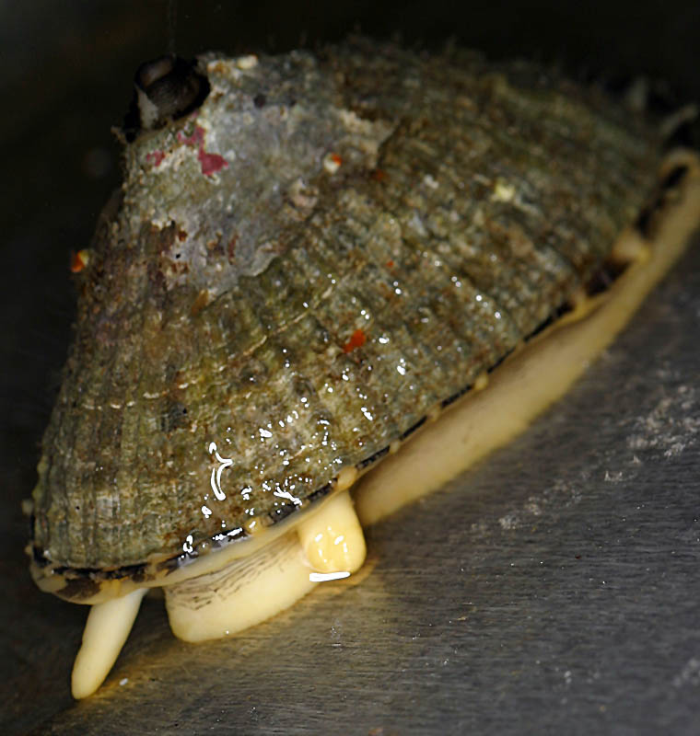
Limpets
1 piece shell
Have a “home” rock
Live in tide pools

Slide 21
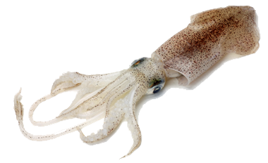
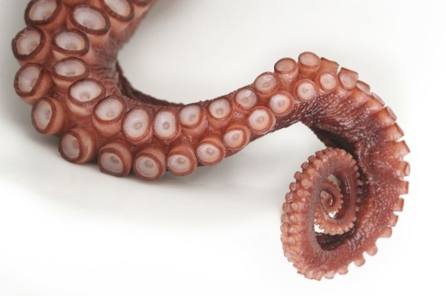
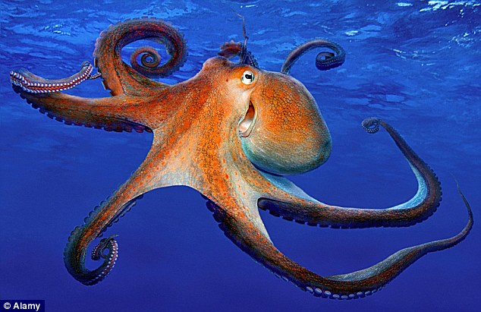
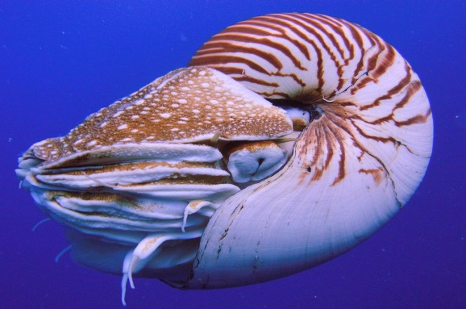
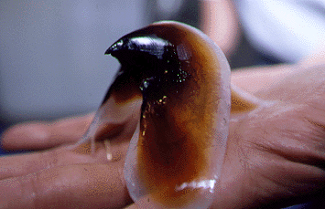
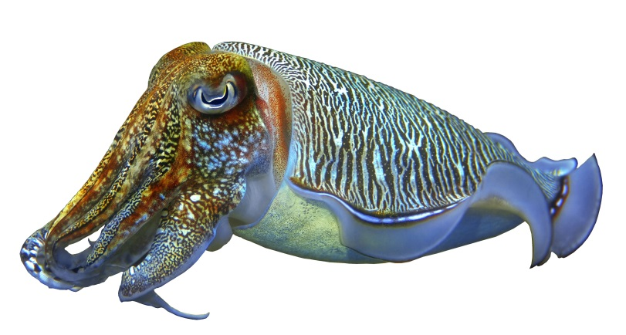
Class Cephalopoda
“Head foot”
Octopus, squid, cuttlefish, nautilus
Most complex mollusks
Head and foot fused
Foot has been modified into tentacles/arms for prey capture, attachment, locomotion, and for reproduction
Tentacles: Octopus (8),
squid (10), nautilus (over 90)
Predators
Mouth has jaws (beak-like) and radula

Slide 22
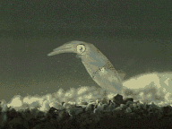
Characteristics: Cephalopods
Closed circulatory system
Exchange of gases, nutrients, and metabolic wastes occurs via diffusion across capillary walls
Brachial hearts (contractile arteries) pump blood across gills
Most have lost shell
(except nautilus)
Exchange protection
for speed
Move via jet
propulsion

Slide 23
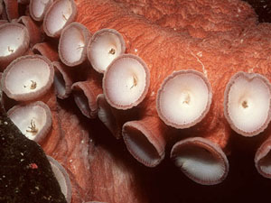
Nervous System
Well developed brain/nervous system
Areas in brain devoted to locomotion, sensory perception, memory and decision making
Eyes (no blind spot),
form images, discriminate
some colors
Very sensitive suckers
Chromatophores (pigment cells)
Contract/expand and change color
Change in combination with ink discharge (distraction mechanism)
Can flicker, blend-in , and used in courtship

Slide 24
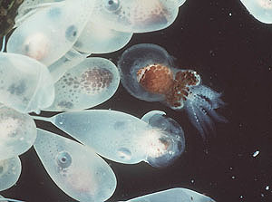
Cephalopod Reproduction
Dioecious
Sperm is retained in spermatophores, transferred to female’s oviduct via a specialized tentacle called a hectocotylus.
Eggs are fertilized as they are leaving oviduct
Deposited singly
or as strings
Female will brood
over young
Hatchlings are mini-adults

Slide 25
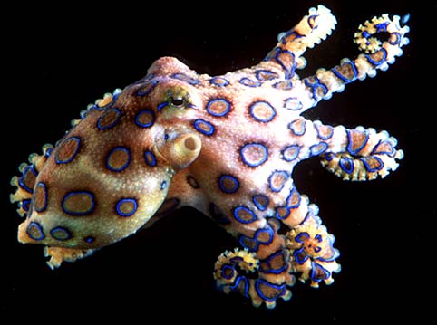
Octopus
Shell is absent
Crawls
Nocturnal
Feeds on snails, fish, crustaceans
Inject venom into prey

Slide 26
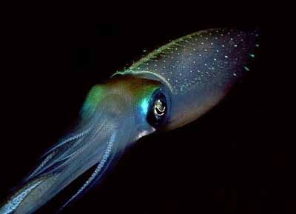
Squid
Shell is reduced to an internal, chitinous structure called a pen.
Feed on fish and shrimp
Can get up to 100 feet long

Slide 27
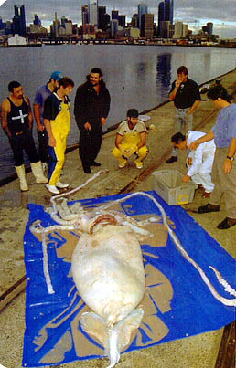
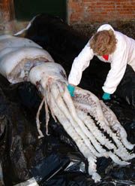

Slide 28
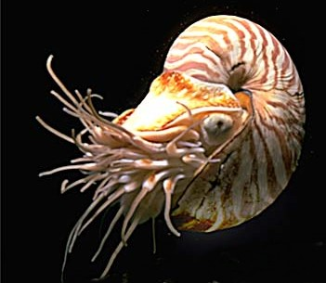
Nautilus
As it grows, moves forward in shell leaving an empty chamber behind.
These chambers are filled with gases and the nautili can regulate the amount of gas in each chamber as it needs to change buoyancy.
Feed on small invertebrates

Slide 29
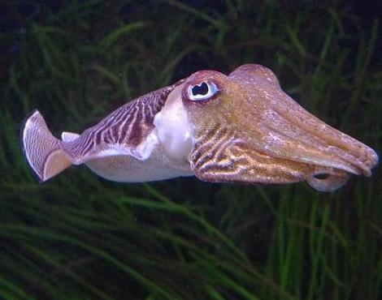
Cuttlefish
Porous, internal shell
Leaves small gas filled spaces for buoyancy
Shell is used to supplement some pet birds’ diet (calcium)
Feed on small invertebrates

Slide 30
Ecological Impact
Zebra mussel (invasive species)
Schistosoma parasite and snails
Brain Research (octopus)
Food
Escargot (snail)
Calamari (squid)
Clams, scallops, and oysters
Jewelry/decoration

