Slide 1
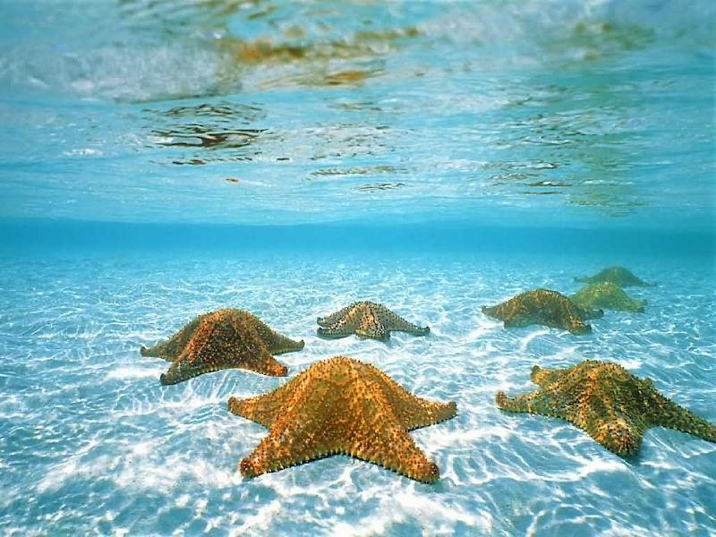
Phylum Echinodermata
“spiny skinned”
~7,000 species

Slide 2
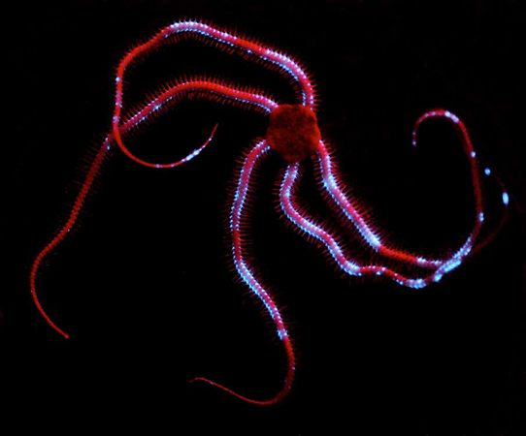
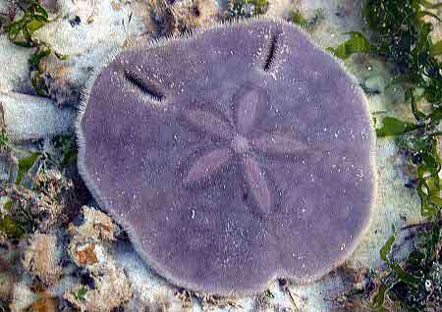
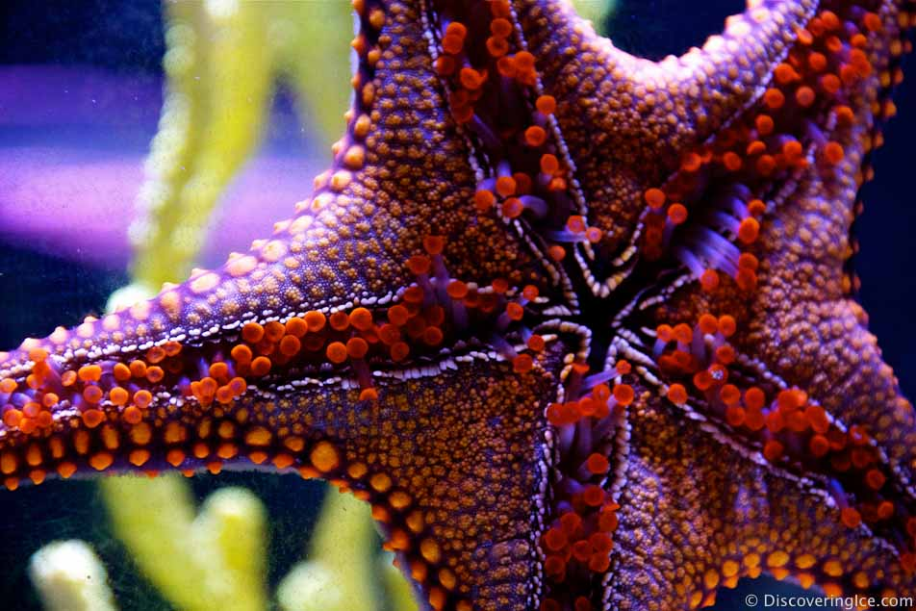
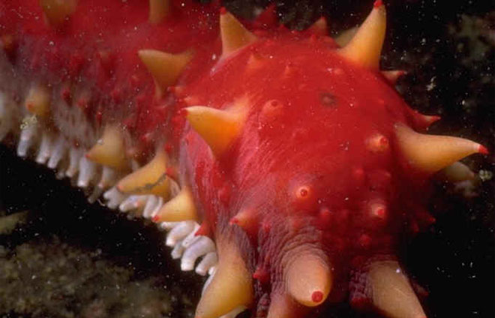
Characteristics
Marine
Calcium carbonate endoskeleton
Spines projected from skeleton
Water vascular system
Locomotion, attachment, feeding
Pentaradial symmetry (adult), bilateral symmetry (larva)
Advantage: Uniform distribution of sensory and feeding structures.

Slide 3
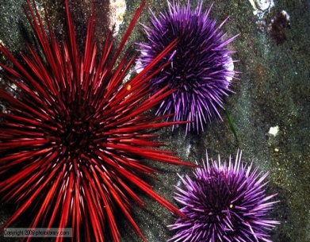
Characteristics
Five or more extensions called arms that surround a central disc.
Hemal system
Tissues that surround the central disc and run down each arm
Aid in distribution of nutrients, hormones, or transporting wastes.
Five successful classes:
Asteroidea:
Ophiuroidea:
-Echinoidea:
-Crinoidea:
-Holothuroidea:

Slide 4
Class Asteroidea
Sea Stars (Starfish)
~1500 species
Arms occur in multiples of 5 (up to 50…crown of thorns starfish)
Mouth
Oriented downward
Surrounded by moveable spines
Tube feet
Hollow cylinders tipped with suckers
Permit the exchange of gases/nitrogenous wastes
Also used in locomotion

Slide 5
Feeding
Class Asteroidea
Feeds on snails, bivalves, crustaceans, polychaetes, coral and detritus
Mouth (oral surface) moves over shell, tube feet create a suction, pull shell open
Turns cardiac stomach inside out and slips it into opening
Digestive enzymes break down the soft body tissue
Draws stomach in along with “food”
Food travels to pyloric stomach →pyloric cecae for further digestion/absorption

Slide 6
Response to the Environment
Class Asteroidea
No brain
Nerve Ring
Surrounds mouth and the radial nerve extends down each arm (ambulacral groove)
Light/chemical sensitive eyespots at the end of each arm
Gills
Respiration
Aboral side, between spines

Slide 7
Movement
Class Asteroidea
Water Vascular System
Water filled canal and extensions to create a skeleton for muscles to contract against
Flow of water
In through madreporite (aboral side) → stone canal →ring canal (surrounds mouth) → radial canal (arms) → lateral canal → tube feet
Bulblike, structures called ampullae contract and force water out of the tube feet which extends them for movement

Slide 8
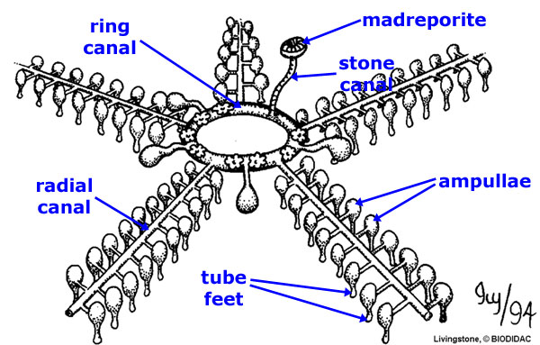

Slide 9
Reproduction
Class Asteroidea
Sexual Reproduction
External Fertilization
Usually dioecious
Respond to environmental factors to release gametes (photperiod/temperature) and pheromones from spawning
May release 2.5 million eggs at once!
2 gonads per arm (enlarge during reproductive periods)

Slide 10
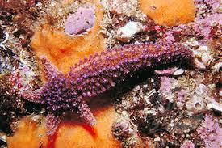
Reproduction
Class Asteroidea
Asexual Reproduction
Regeneration
As long as the arm contains part of the central disc, then it can regenerate into a new starfish.
May take years.

Slide 11
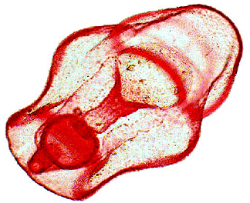
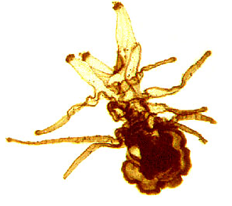
Starfish Development
Biplannaria (1st larval stage)
Ciliated bands for locomotion and feeding
Free-swimming
Brachiolaria
Arms and a sucker to hold in place until metamorphosis is complete.

Slide 12
Class Echinoidea
Sand dollars and Sea Urchins
No arms
Tube Feet
Skeleton is called a test
Covered in spines
Can be long and prominent (sea urchins)
Short and felt-like (sand dollars)
Mouth has five hard “teeth” known as Aristotle’s lantern (for chewing)
Dioecious, external fertilization
Radial or Biradial Symmetry

Slide 13
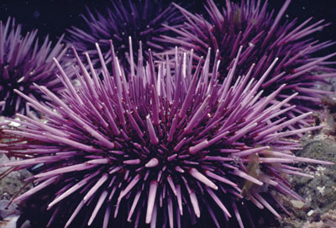

Slide 14
Class Ophiuroidea
Brittle stars and Basket stars
~2000 species
Grasping type movement
Predators/Scavengers
Tube feet lack suction
water vascular system not used for movement

Slide 15
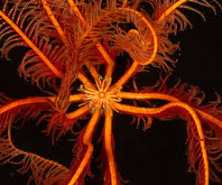
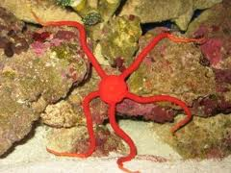
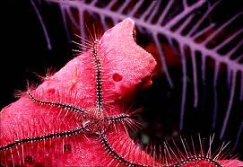
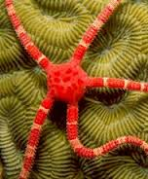

Slide 16
Class Holothuroidea
Sea cucumber
~1500 species
Soft cylindrical body-warty skin
Crawl over surfaces or burrow through substrates

Slide 17
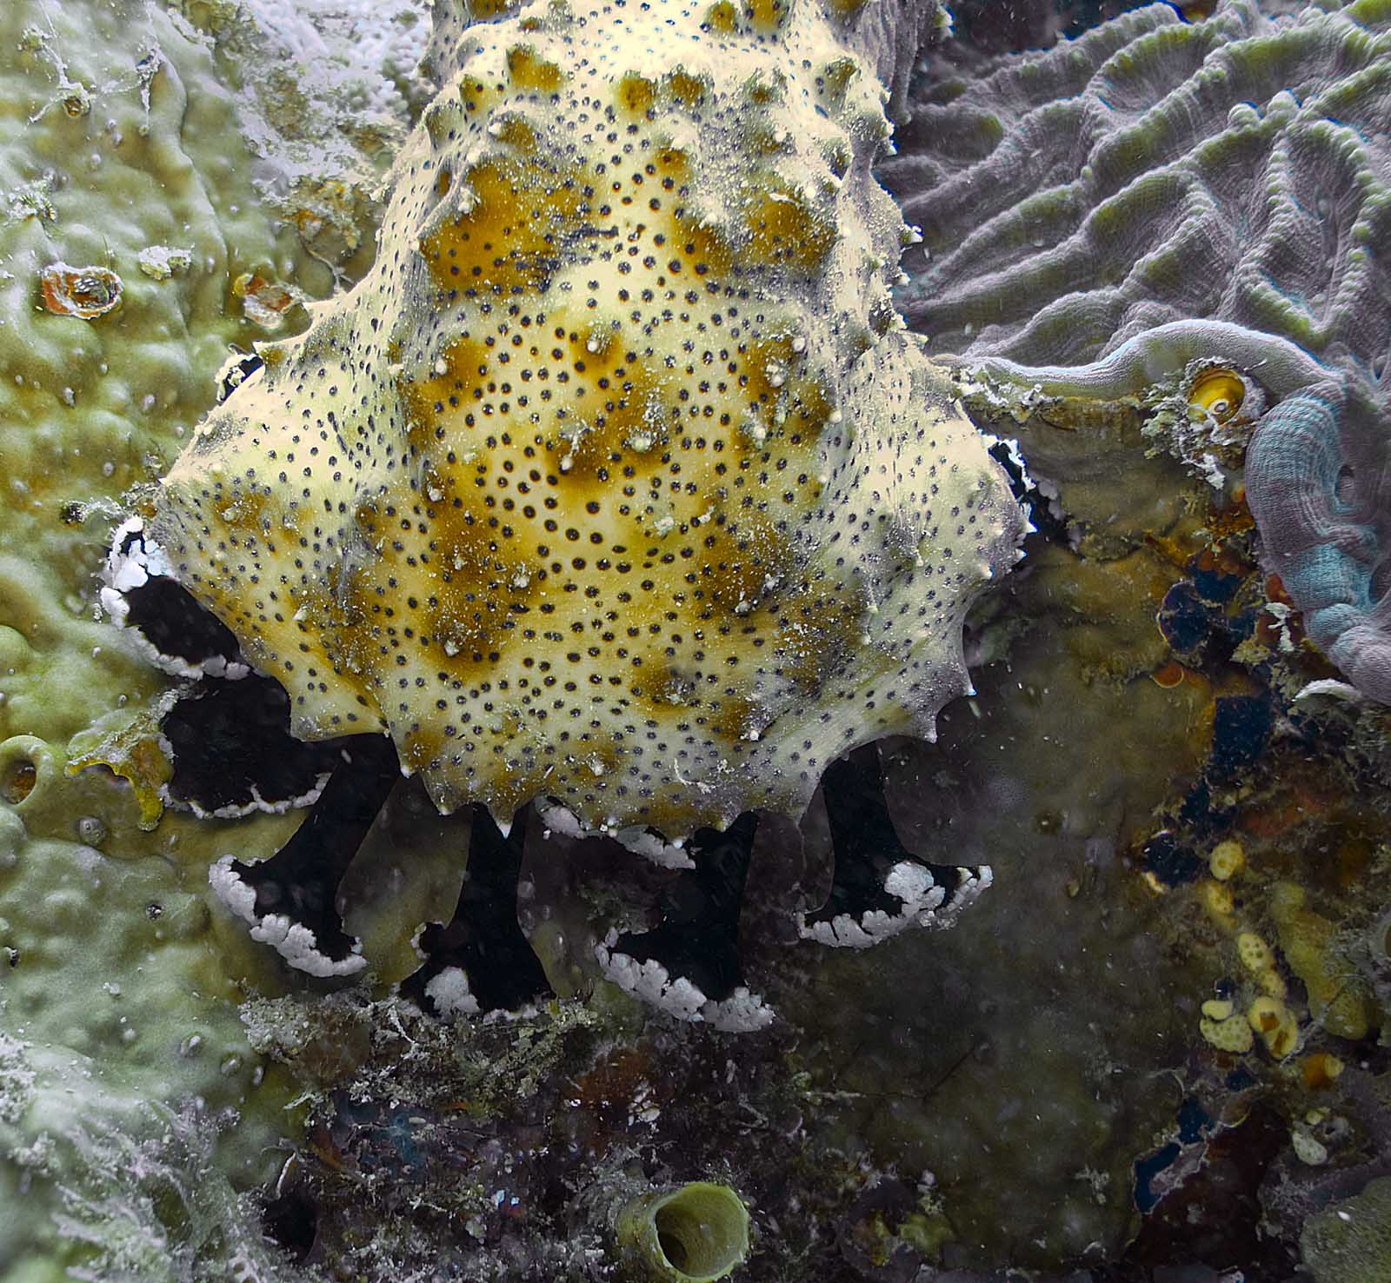
Class Holothuroidea
Endoskeleton is reduced to spicules (lacks spines and pincers)
No arms
Move by contractions of body wall muscles
Short tentacle-like tube feet around mouth for burrowing and feeding

Slide 18
Class Holothuroidea
Defense mechanisms
Respiratory tree (gas exchange)
Attaches at rectum and branches through body cavity
Can be expelled from anus to entrap enemies (Cuverian tubules)
Some can even eject internal organs and regenerate them!
Some have toxins in body wall

Slide 19
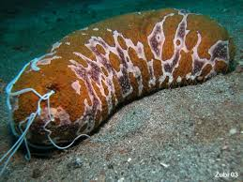
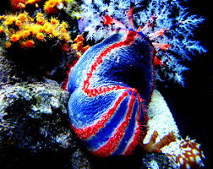
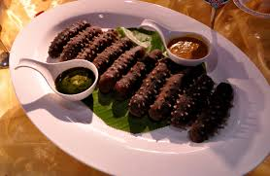
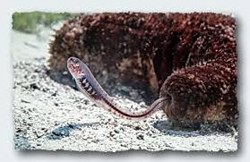

Slide 20
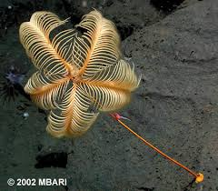
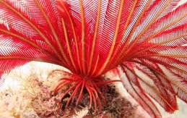
Class Crinoidea
Sea lillies
Permanently attached by stalk
Feather stars
Lack a stalk, swim/crawl along surface

Slide 21
