Slide 1
Phylum Chordata

Slide 2
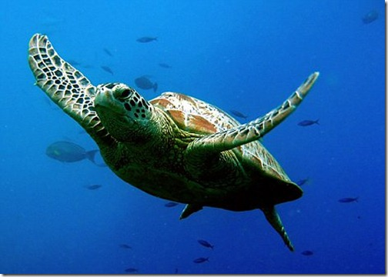
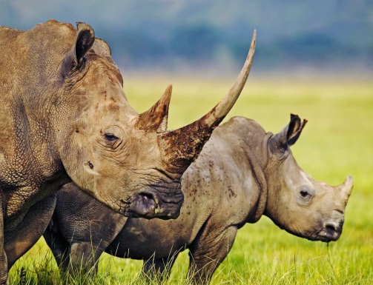
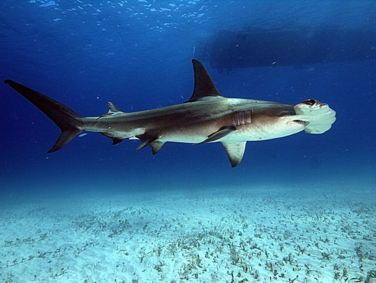
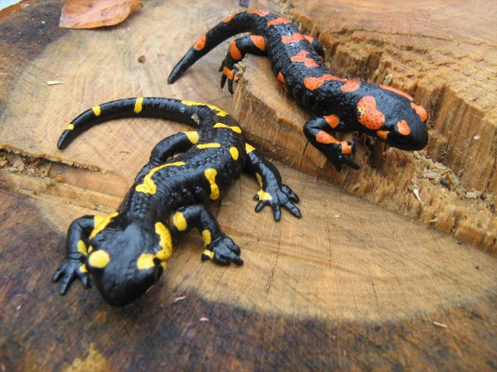
Chordate Characteristics
Dorsal Nerve Cord
Anterior end of organism becomes the brain
Postanal tail
Notochord
Long, thin, firm cord that extends down the back of the animal
Pharyngeal (gill) slits
Paired openings in the throat region (respiration or modified)

Slide 3
Subphylum Vertebrata
Class Myxini
Class Cephalaspidomorphi
Class Chondrichthyes
Class Osteichthyes
Class Amphibia
Class Reptilia
Class Aves
Class Mammalia

Slide 4
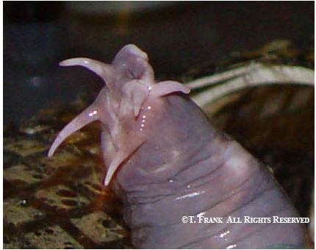
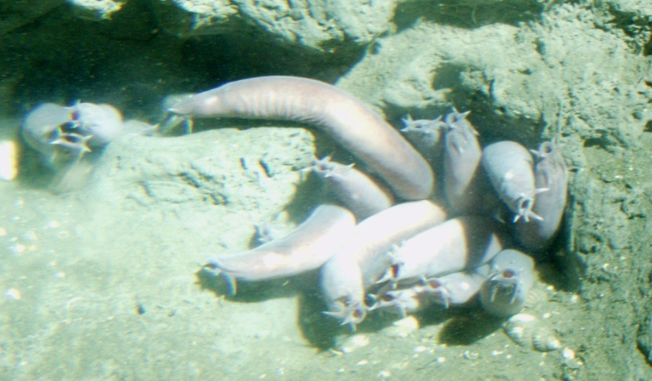
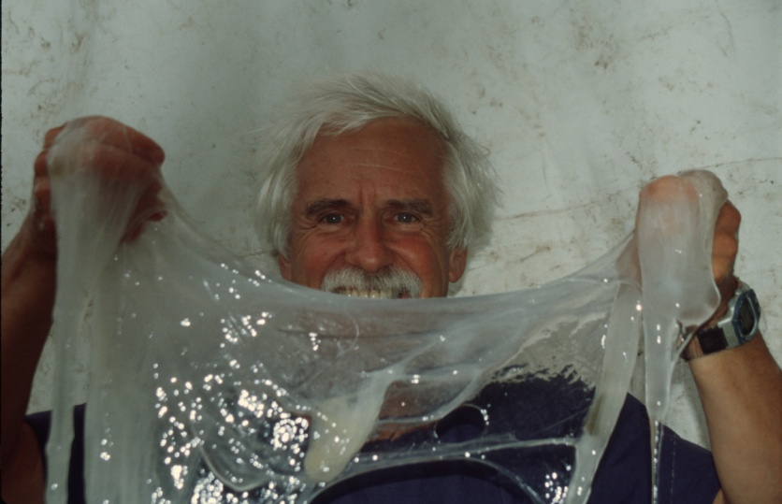
Class Myxini
Hagfishes
20 species
Head is supported by cartilaginous bars, lack vertebrae.
Sensory tentacles around the mouth
Slime glands
Found in cold water marine environments

Slide 5
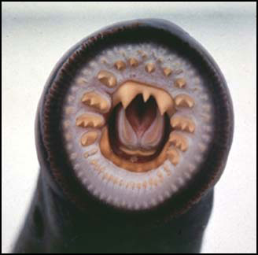
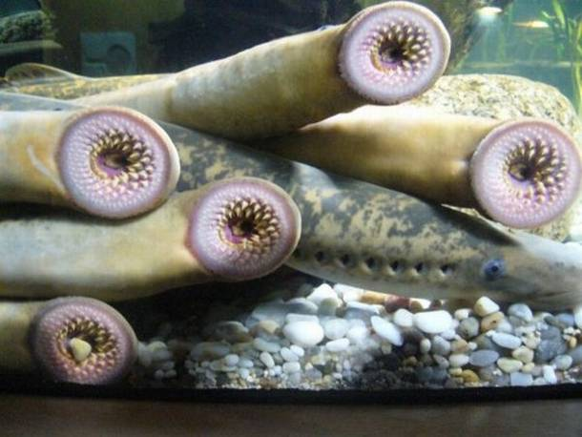
Class Cephalaspidomorphi
Lampreys
Marine and freshwater environments
Adults feed on other fish, larvae are filter feeders
Teeth line the mouth and cover a movable tongue-like structure
Attach to prey and rasp away scales
Release anti-coagulant

Slide 6
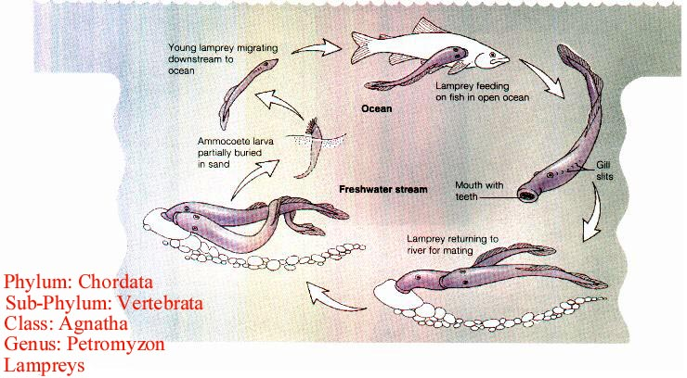
Lamprey Reproduction

Slide 7
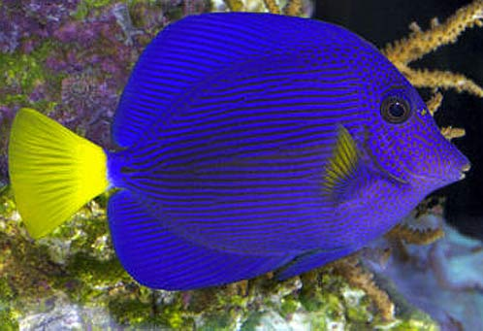
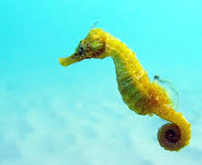
Jawed Fishes
Jaws allow for more efficient gill ventilation and the capture and ingestion of a variety of food sources
Paired appendages allowed for increased activity and stability
Both contributed to the predatory lifestyle which in turn allowed them to produce more offspring and exploit new habitats

Slide 8
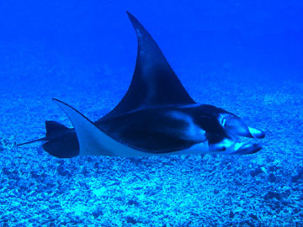
Cartilaginous Fishes: Class Chondrichthyes
Sharks, skates, rays, and ratfishes
Marine
Carnivores and/or Scavengers
Biting mouthparts, paired appendages, placoid scales, and cartilaginous endoskeletons
Can be oviparous, ovoviviparous or viviparous

Slide 9
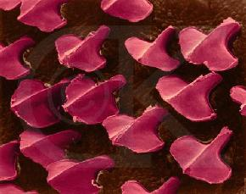
Cartilaginous Fishes: Class Chondrichthyes
Scales
Gives skin a sand-papery feel
Project posteriorly to reduce friction when swimming
Teeth
Modified scales
As teeth are worn down, they are shed, and newer ones are pushed forward
This happens every 7-8 days in younger sharks

Slide 10
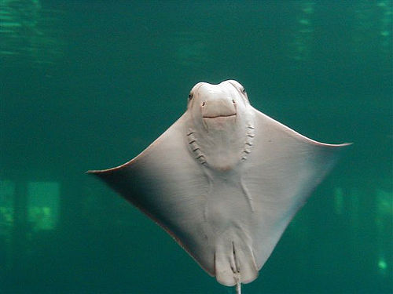
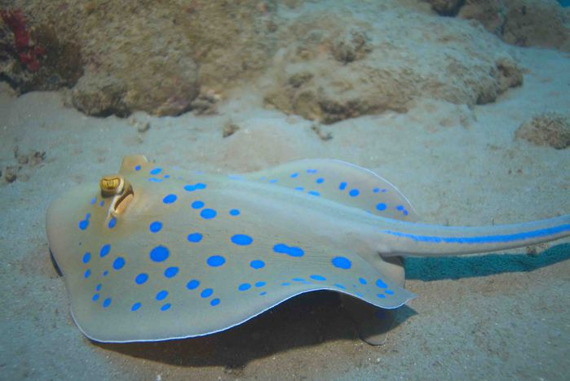
Skates and Rays
Specialized for life on the ocean floor
Lateral expansion of the pectoral fins into wing-like appendages
Feed on invertebrates

Slide 11
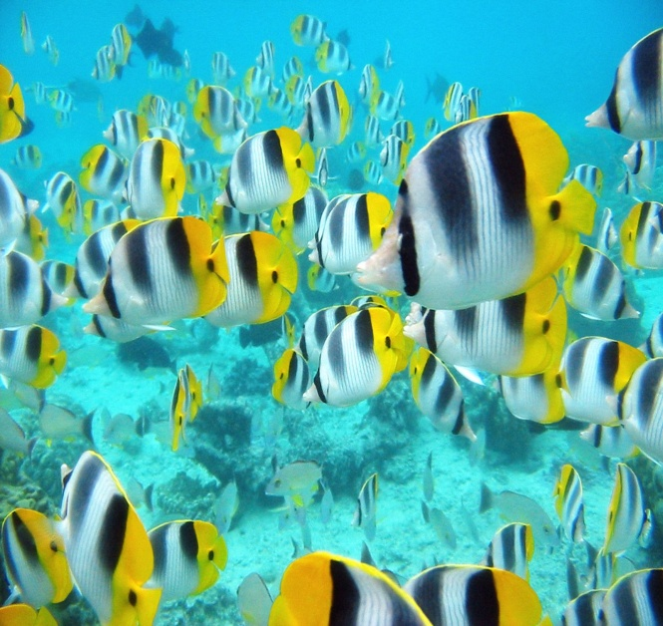
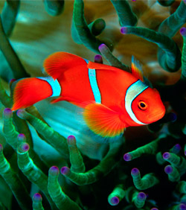
Circulation and Gas Exchange
Closed circulatory system
Heart pumps blood, RBC’s contain hemoglobin, arteries, capillaries, and veins
Blood→gills (oxygenation takes place)→back to heart to be pumped to the rest of the body
Gas exchange
Water is constantly being pumped into the mouth and pharynx and out through the gills.
Sharks do not have an opercula so most have to constantly stay moving.
Some sharks can “pump” water in through the mouth and over the gills

Slide 12
Nervous and Sensory Functions
Brain and spinal cord
Sensory receptors all over body for touch, temperature, olfaction, vision, hearing, equilibrium and balance, and for detecting water movements.
Lateral-line system
Sensory pits in the epidermis that connect to canals just below epidermis.
Stimulated by water moving around them.
Notes:
Olfaction…aid in finding previous spawning grounds (salmon and lampreys)
Lidless eyes: focus requires moving the lens forward or backward in the eye…as opposed to changing the shape of the lens.
Equilibrium, balance, and hearing are in the inner ears of fishes.

Slide 13
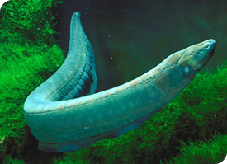
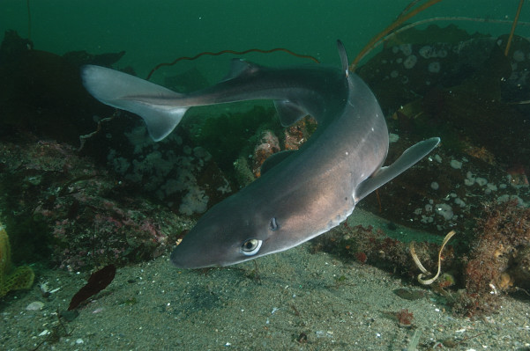
Electroreception
All organisms produce weak electrical fields from the activities of nerves and muscles.
Most fish have the ability to detect these fields (find prey)
Dogfish shark use this method to find food buried in the sand.
Some use electroreception (for use in murky water where eyes are not valuable
Notes:
Shocks are sufficiently strong enough to stun or kill prey, discourage large predators, and teach unwary humans a lesson!

Slide 14
Reproduction and Development
Most fish are oviparous
Some sharks, skates, and rays are ovoviviparous (dogfish sharks)
Young are nourished by a yolk sac, but development takes place inside the female.
Others are viviparous (hammerheads and gray reef sharks)
Sperm transfer is aided by claspers (internal)
Brooding is rare…however some have nests, some use their mouths

Slide 15
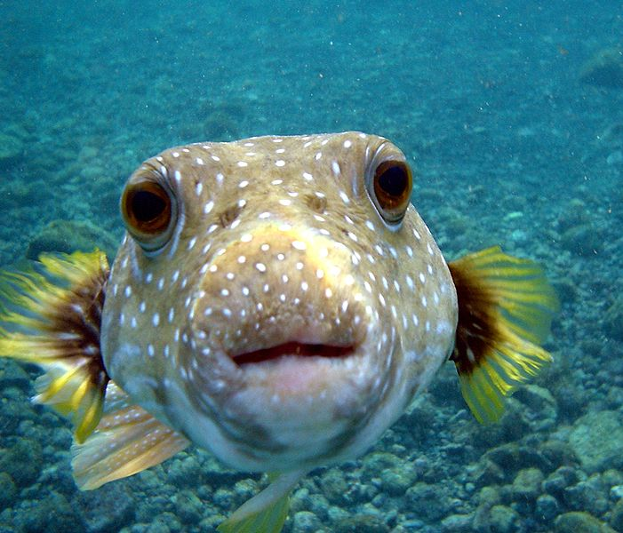
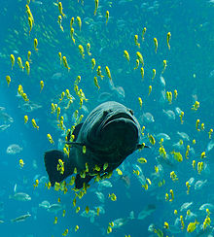
Class Osteichthyes
Bony skeleton
Scales
Operculum covering the gill openings
Lungs/or a swim bladder

Slide 16
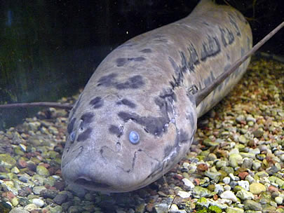
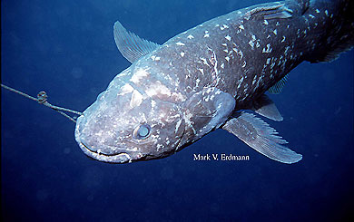
SubClass Sarcopterygii
Muscular lobes
Use lungs for gas exchange
Lungfishes
Live in areas that go through periods of droughts
Burrow in mud
6 month or more
Coelacanths
Large, thought to have
been extinct

Slide 17
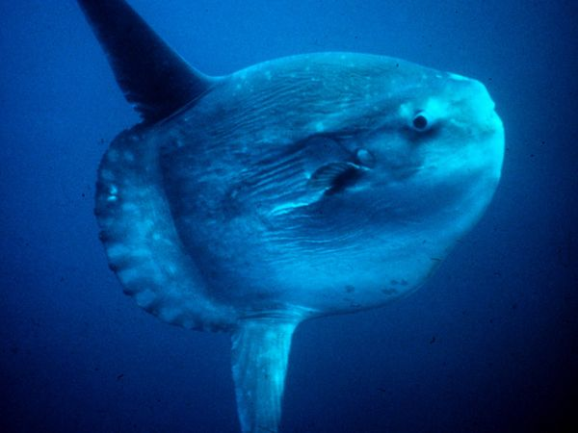
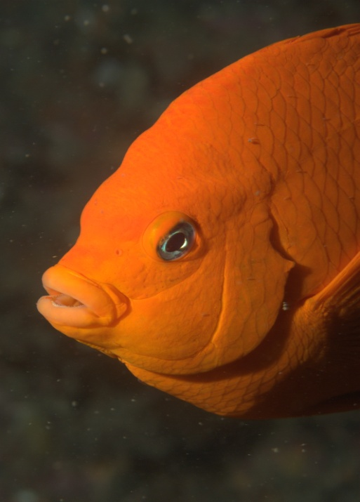
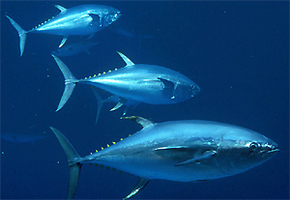
SubClass Actinopterygii
Ray-finned fishes
Swim bladders (regulate buoyancy)
Locomotion
Energy efficient due to the streamlined shape of the fish and the mucoid secretions that lubricate its body surface (reduce friction)

Slide 18
Feeding
Diets vary: filter feeders/predators/herbivores
Usually swallow prey whole
Create a suction by closing off the operculum and rapidly opening and closing the mouth
Some have teeth that hold prey or are used to crush the shells of molluscs
Stomach stores food, small intestine is for digestion and absorption

Slide 19
Circulation and Gas Exchange
Closed circulatory system
Heart pumps blood, RBC’s contain hemoglobin, arteries, capillaries, and veins
Blood→gills (oxygenation takes place)→back to heart to be pumped to the rest of the body
Gas exchange
Water is constantly being pumped into the mouth and pharynx and out through the gills.
Sharks do not have an opercula so most have to constantly stay moving.
Some sharks can “pump” water in through the mouth and over the gills

Slide 20
Why can you float in water?
LUNGS!
Fishes have the following to help them maintain buoyancy:
Oil based compounds in tissues (liver)
Fins to provide lift
Reduction of heavy tissues
Swim bladder
Regulate the volume of gas…just as you can in your lungs!

Slide 21
Nervous and Sensory Functions
Brain and spinal cord
Sensory receptors all over body for touch, temperature, olfaction, vision, hearing, equilibrium and balance, and for detecting water movements.
Lateral-line system
Sensory pits in the epidermis that connect to canals just below epidermis.
Stimulated by water moving around them.
Notes:
Olfaction…aid in finding previous spawning grounds (salmon and lampreys)
Lidless eyes: focus requires moving the lens forward or backward in the eye…as opposed to changing the shape of the lens.
Equilibrium, balance, and hearing are in the inner ears of fishes.

Slide 22
Electroreception
All organisms produce weak electrical fields from the activities of nerves and muscles.
Most fish have the ability to detect these fields (find prey)
Dogfish shark use this method to find food buried in the sand.
Some use electroreception (for use in murky water where eyes are not valuable
Notes:
Shocks are sufficiently strong enough to stun or kill prey, discourage large predators, and teach unwary humans a lesson!

Slide 23
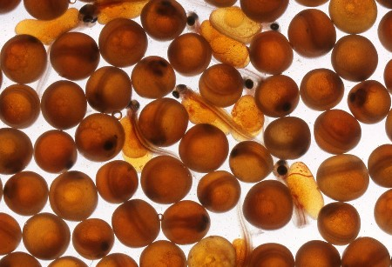
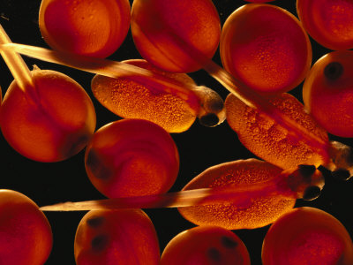
Reproduction and Development
Increasing chances of survival is
accomplished by:
Variety of mating behaviors
Nesting behaviors that protect eggs from predation or harsh environmental factors
Producing overwhelming numbers of eggs
Some won’t be fertilized, may wash ashore or dry out, currents/tides will smash embryos, and others may fall to predation
Notes:
Mating in large schools, pheromones are released

Slide 24
Reproduction and Development
Most fish are oviparous
Some sharks, skates, and rays are ovoviviparous (dogfish sharks)
Young are nourished by a yolk sac, but development takes place inside the female.
Others are viviparous (hammerheads and gray reef sharks)
Sperm transfer is aided by claspers (internal)
Brooding is rare…however some have nests, some use their mouths

