Slide 1
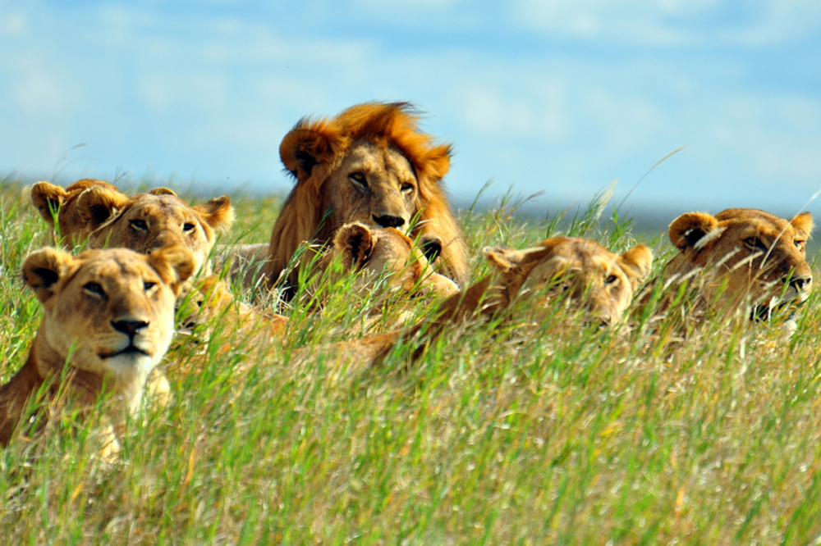
Class Mammalia

Slide 2
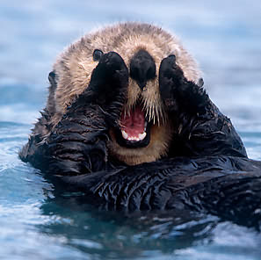
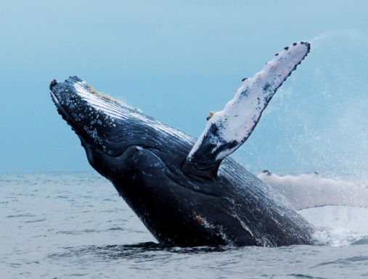
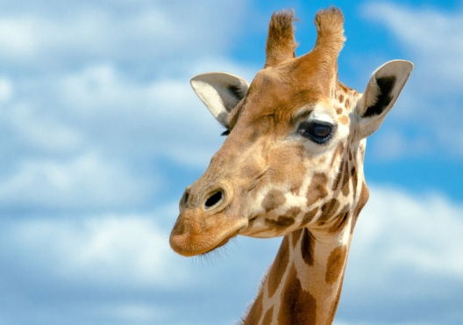
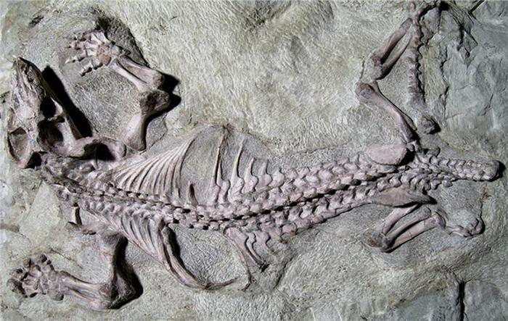
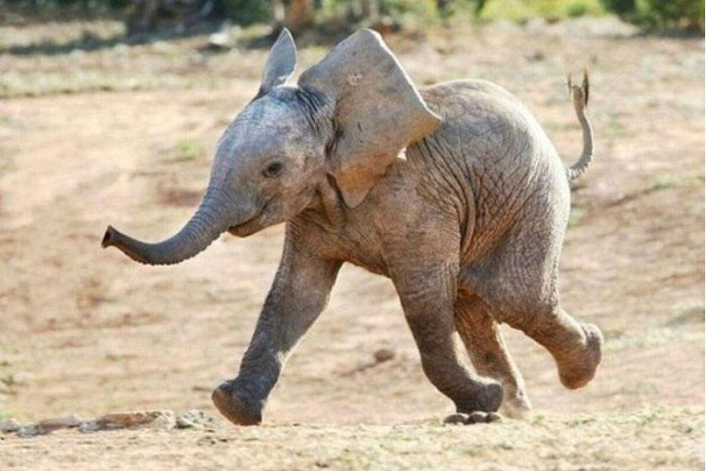
First mammals were small with delicate skeletons, acute senses, and possibly nocturnal.
Avoid competition with larger organisms

Slide 3
Mammalian Characteristics
Hair or fur (pelage)
Keratin
Periodically molted
Insulating
Important to sense/touch
Most have claws, nails, or hooves

Slide 4
Mammalian Characteristics
Glands
Sebaceous: oil
Lubricates/waterproofs the hair/skin
Sudoriferous: sweat
evaporative/cooling
Scent or musk
Release pheromones
Involved in defense, species/sex recognition, and territorial behavior
Mammary (functional in females only)
Monotremes: no nipples, just depressions

Slide 5
Mammalian Characteristics
Skulls and teeth
Single articulation of the jaw bone
More extensive secondary palate (can chew and breathe)
Specialized teeth
Most have two sets (deciduous and permanent)
Types of teeth based upon diet

Slide 6
Mammalian Characteristics
Skeleton and muscles
Most have 7 cervical vertebrae (including giraffes!)
Manatees (6), tree sloths (6 or 9).
Trunk is divided into thoracic and abdominal cavities by diaphragm
Skeleton bears the body weight.

Slide 7
Mammalian Characteristics
Nutrition and Digestion
Specialized to diet
Cecum: fermentation pouch at the junction of large/small intestine
Herbivores (horses, rabbits, and rodents)…aids in the digestion of cellulose.
Ruminants: four chambers in stomach
First three are for storage and fermentation
Sheep, cattle and deer

Slide 8
Mammalian Characteristics
Circulation and Gas Exchange
Four chambered heart
Circulation between mother/fetus: placental
No blood is exchanged, just diffusion of nutrients, gases and wastes.
High metabolic rates require adaptations for efficient gas exchange
Efficient lungs, muscular diaphragm

Slide 9
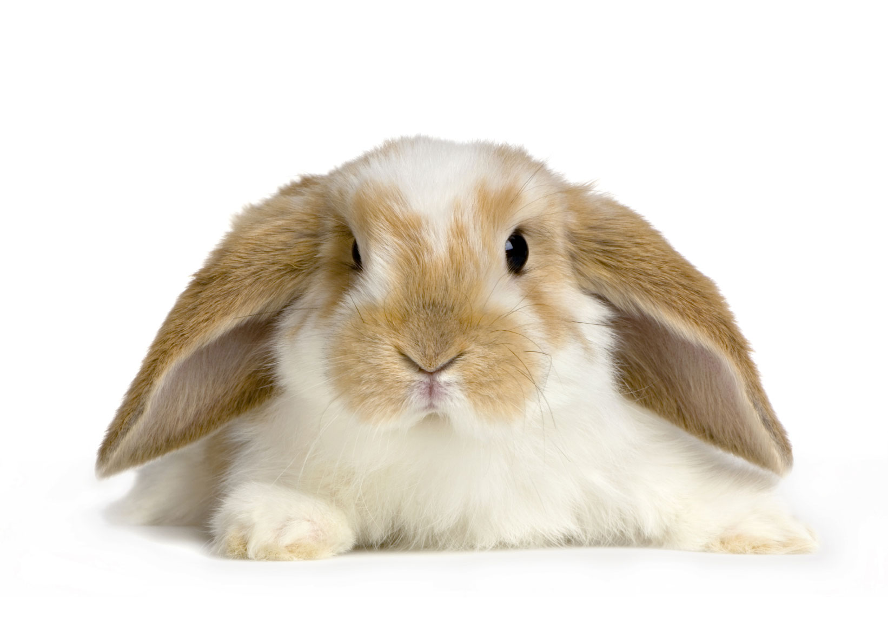
Mammalian Characteristics
Warm-blooded
Heat production by shivering and brown fat (special fat deposits, sustains high metabolic rate)
Heat reduction through ears, tails, panting, burrowing or finding shade

Slide 10
Mammalian Characteristics
Winter sleep or hibernation
Hypothalamus slows down metabolic heart rate and respiratory rates
Ex: ground squirrel, lowers body temp to 35F, 100-200 breaths/minute to 4, 200-300 beats/min to 20! May lose 1/3 of body fat!
Behavioral: migrations/burrows

Slide 11
Mammalian Characteristics
Nervous system
Complex-enlarged cerebral cortex
Plays a key role in memory, attention, awareness, thought, language and consciousness
Acute senses: touch, smell (species recognition, avoid predation), auditory, vision (most not in color)
High sense of touch

Slide 12
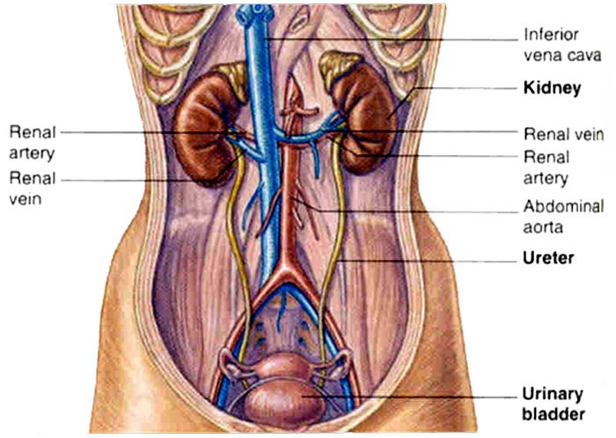
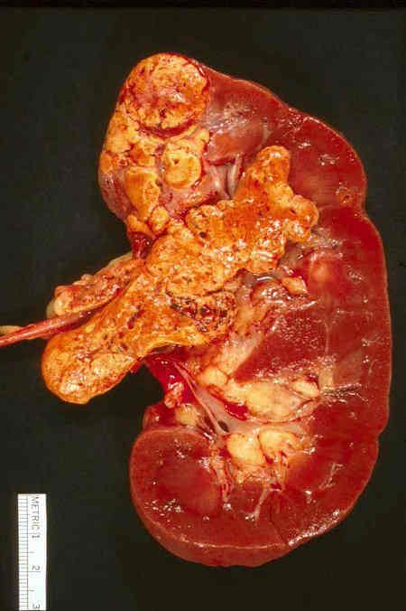
Mammalian Characteristics
Excretion
Metanephric kidneys excrete urea (more water loss)

Slide 13
Mammalian Characteristics
Reproduction
Most have cycles that are hormone regulated
Estrus (heat)
Ova are mature and female is sexually receptive behaviorally/physiologically
Menstrual cycles (humans/great apes)
Interdependent between brain, pituitary gland, and ovaries/uterus.

Slide 14
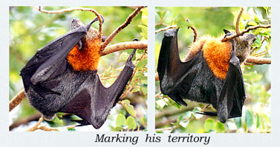
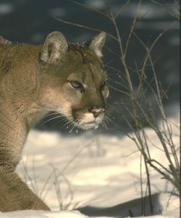
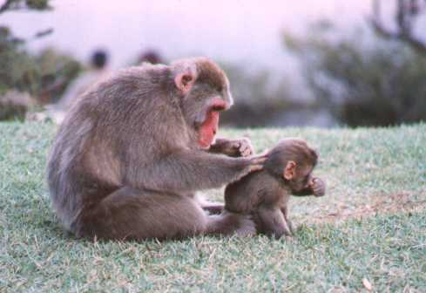
Mammalian Characteristics
Complex Behaviors
Visual
Pheromones/marking
Grooming
Territorial

Slide 15
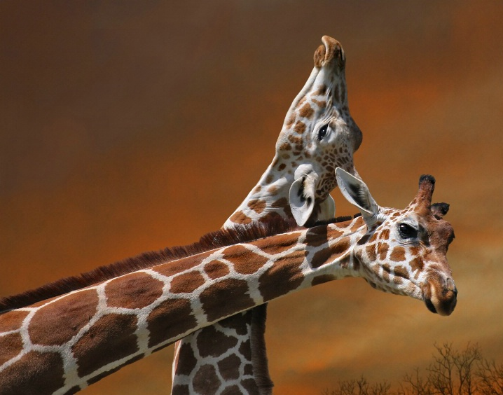
Two giraffes battle one another over a breeding female.

Slide 16
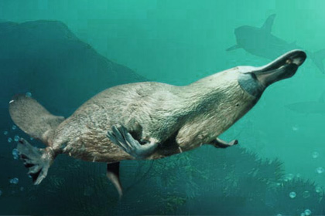
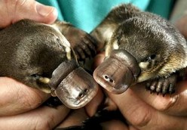
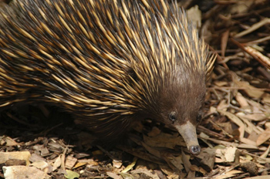
Mammalian Grouping
Monotremes (6 species)
Egg layers

Slide 17
Mammalian Grouping
Marsupials (250 species)
Viviparous with pouch
Kangaroos, opossums, koala, wombats, Tasmanian devils
Yolk-type placenta, short gestation times, embryo moves to mother’s pouch to finish development

Slide 18
Mammalian Grouping
Placental
3800 species
21 orders
Young are nourished via diffusion of gases/nutrients/waste across the placenta.

Slide 19
hedgehogs
moles
Order Insectivora
(third largest)
shrews
tenrecs

Slide 20
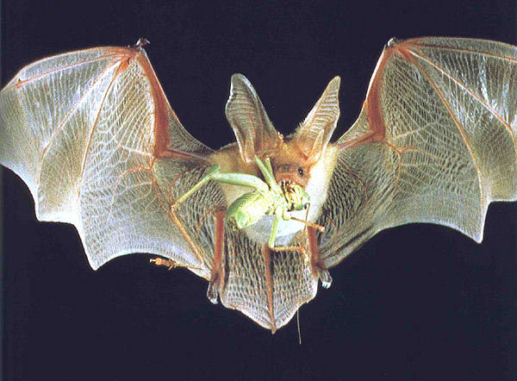
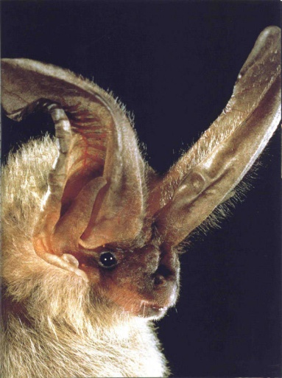
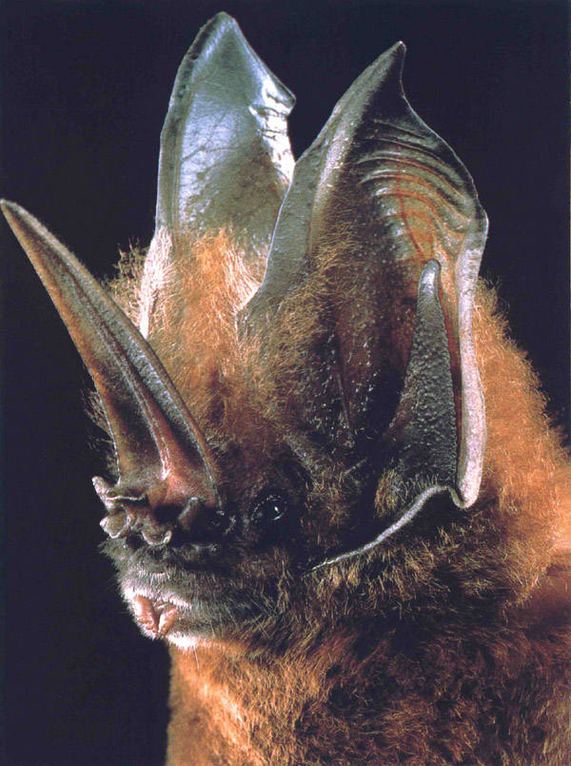
Order Chiroptera
bats
(second largest)

Slide 21
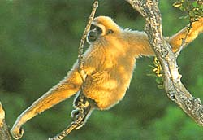
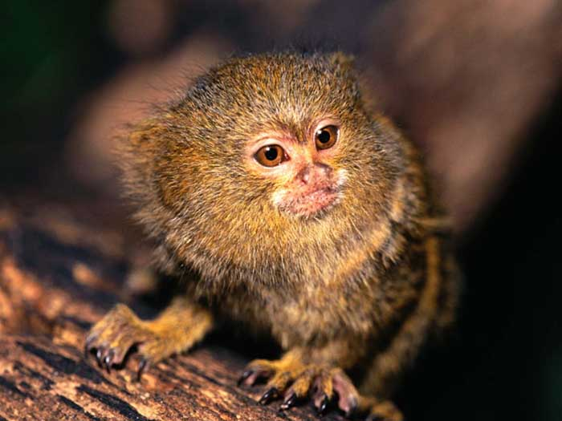
Order Primates

Slide 22
Order Xenartha
Formerly Edentata

Slide 23
Order Lagomorpha

Slide 24
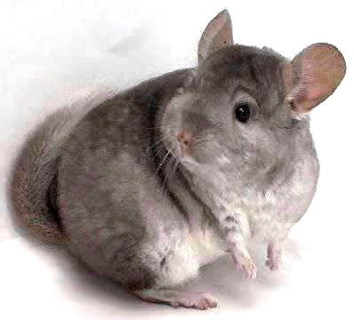
Order Rodentia
(largest)

Slide 25
Order Cetacea

Slide 26
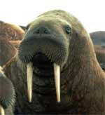
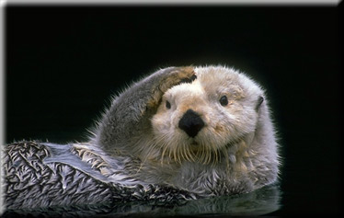
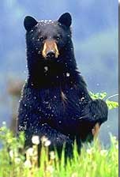
Order Carnivora

Slide 27
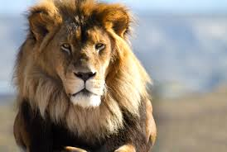
Animal Spotlight: Lion

Slide 28
Order Proboscidea

Slide 29
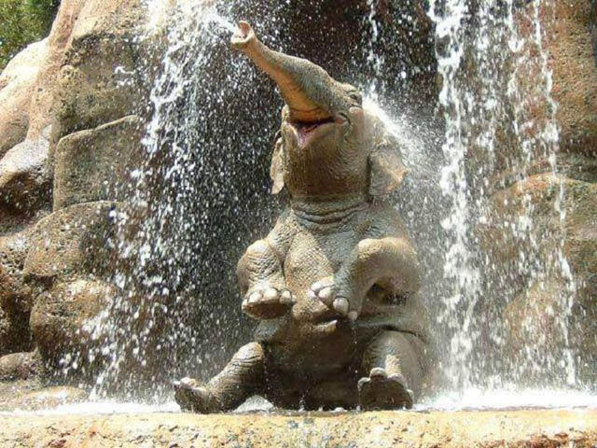
Animal Spotlight: Elephant

Slide 30
Order Sirenia

Slide 31
Order Perissodactyla

Slide 32
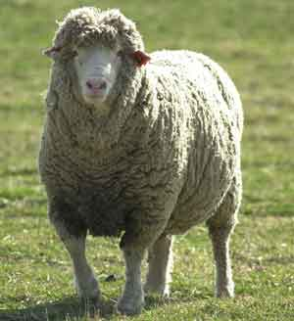
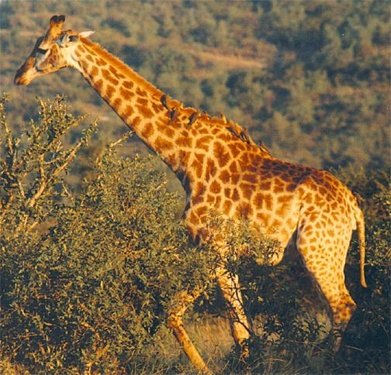
Order Artiodactyl

Slide 33
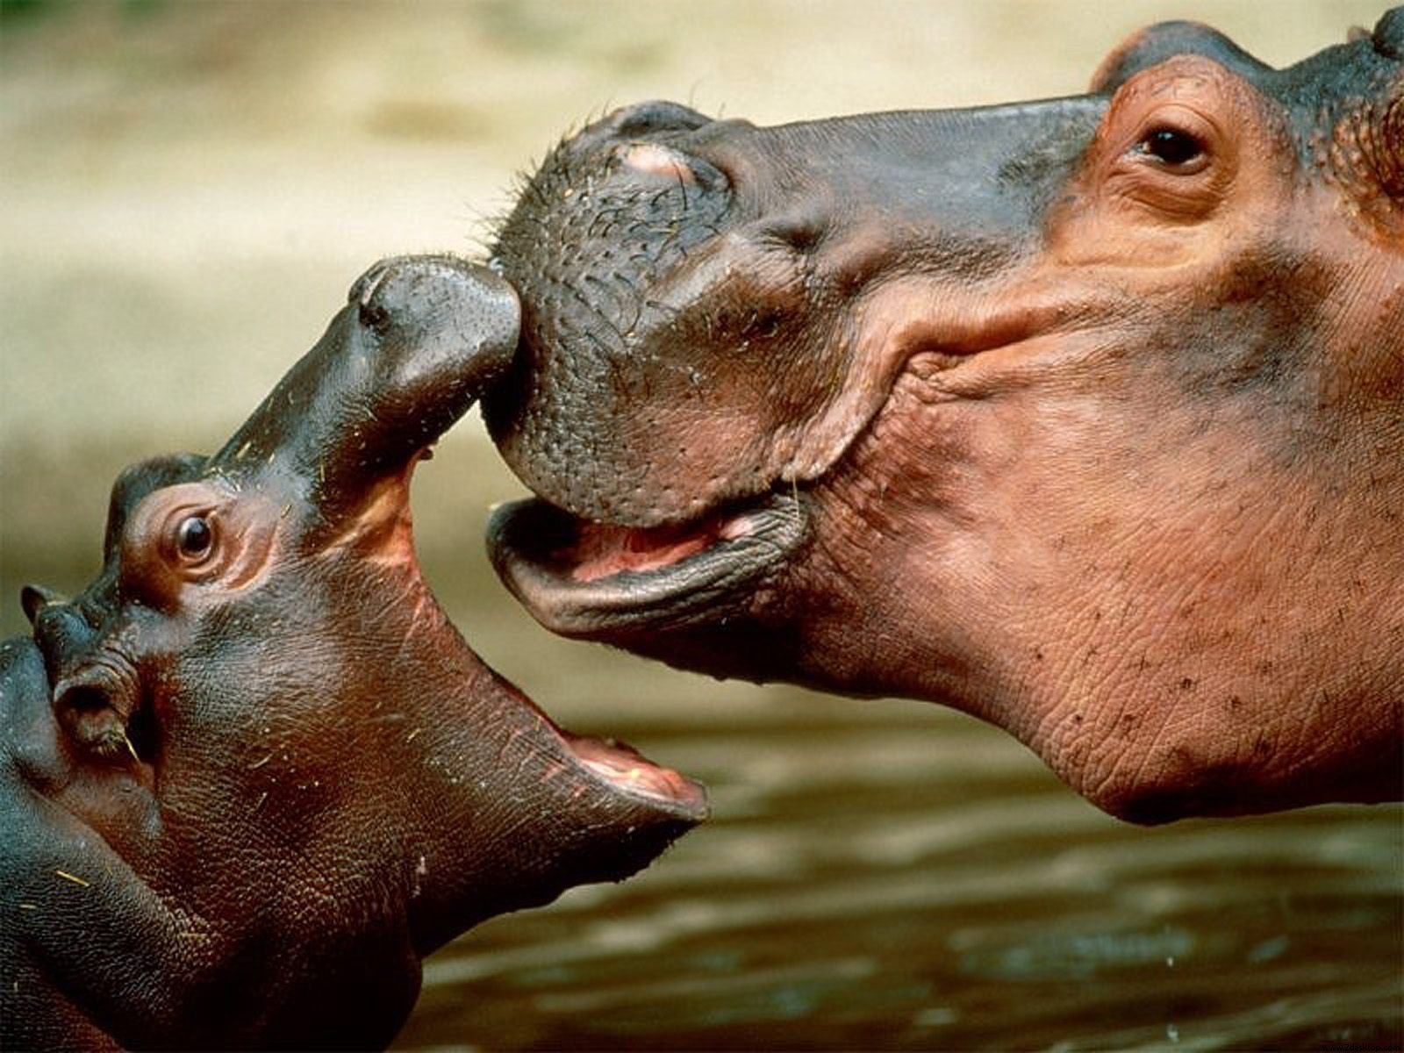
Hippo Spotlight

Slide 34
largest colonies
largest rodent
capybara
prairie dogs
can kill snakes
can roll in ball
mongoose
pangolin

Slide 35
highest altitude
"man of the forest"
yak
orangutan
largest monkey
largest herds
mandrill
springbok

