Slide 1
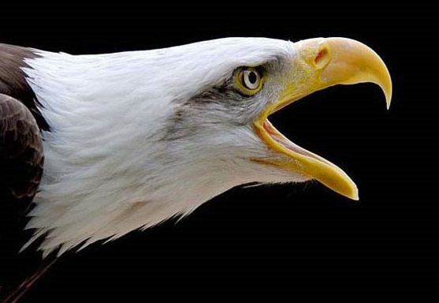
Class Aves

Slide 2
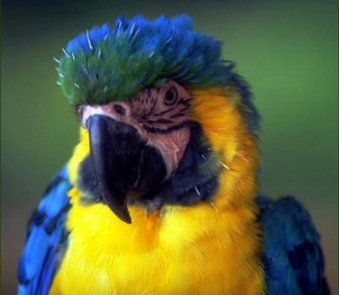
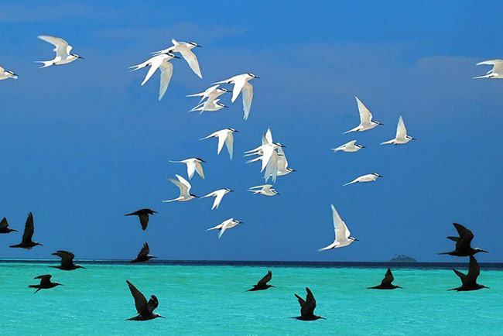
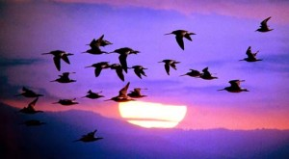

Slide 3
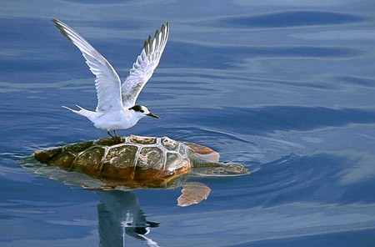
Avian and Reptilian Similarities
Skeletal
Single occipital condyle
Single ear ossicle
Lower jaw structure
Physiological
Nucleated RBC’s
Similar liver and kidney functions
Behavioral
Nesting and parental care

Slide 4
Adaptations for flight
Acute Senses
Endothermy
Lightweight Bones
Long, flexible necks
Feathers

Slide 5
External Structure and Locomotion
Plumage: covering of feathers
Form the flight surface that provides lift and aid steering
Prevent excessive heat loss
Permits easy maintenance of high MRs.
Feathers also play a role in courtship, incubation and waterproofing.

Slide 6
External Structure and Locomotion
Pennaceous feathers
Central shaft (barbs radiate from this)
Create the aerodynamic surface
Plumulaceous feathers
Barbs and barbules do not interlock, wispy appearance
Down feathers
Provide insulation
Notes:
Penaceous modified for flight (line the tip and trailing edge of the wing, asymmetrical with longer barbs on one side of the shaft)
Also countour: asymmetrical and line the body and cover the base of the flight feathers…provide waterproofing, insulation, and streamlining.

Slide 7
External Structure and Locomotion
Feather maintenance
Preening (rubbing the bill over the feathers)
Removes parasites
Keeps feathers smooth and in place
Cleans the feathers
Oil glands at the base of the tail release secretions that keep the plumage water repellant and supple.
Anting is done by rubbing an ant over
the feathers (the ant’s formic acid is toxic to
the feather mites)

Slide 8
External Structure and Locomotion
Molting
Mature feathers receive constant wear, so occasionally feathers are molted.
Young are born with down feathers
A number of periodic molts occur after that
Sometimes birds will not be able to fly during the molting period.

Slide 9
Skeleton
Bones are lightweight, yet strong
Bones have large air spaces (but they are strutted)
Some have dense bones (to aid in diving)
High degree of rotational movement of the head

Slide 10
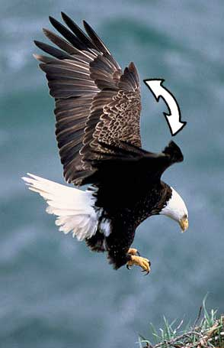
Muscles and Flight
Flight muscles have many mitochondria to make lots of ATP.
Wings are adapted for different types of flight…but all wings form an airfoil.
Airfoil
Air passing over the wing travels farther
and faster than air passing under it.
Alula
Reduces turbulence
Tails
Used for balance, steering, and braking.

Slide 11
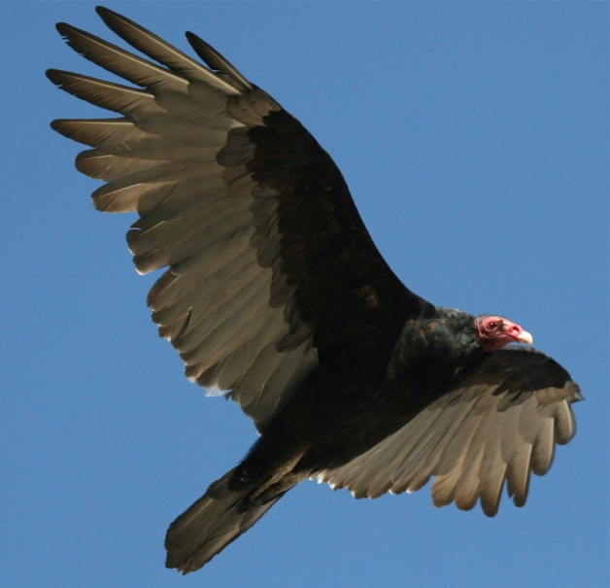
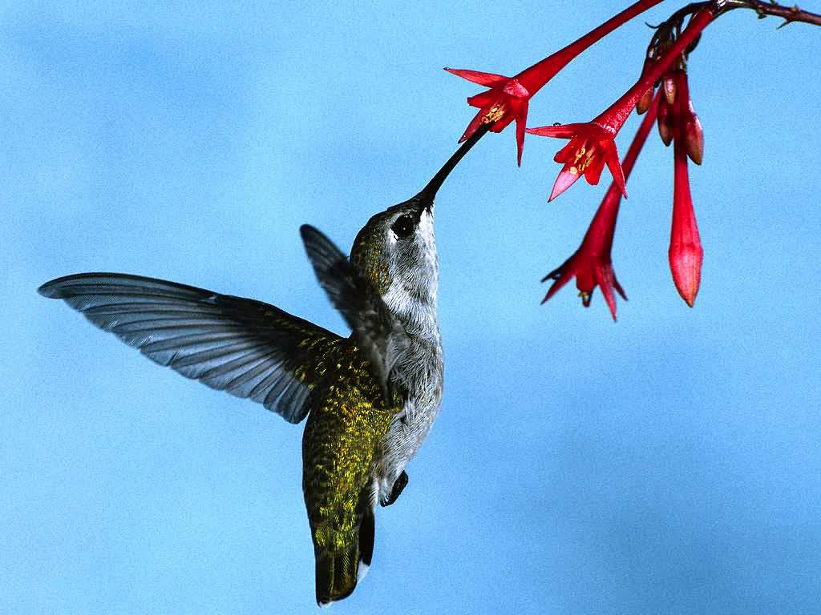
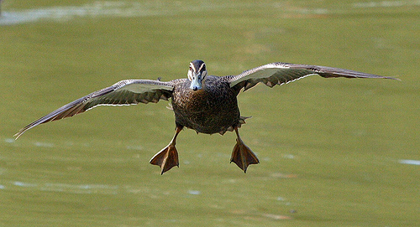
Types of flight
The types of flight varies per species:
Gliding: wings are stationary, lowers altitude
Flapping: generates power, most common
Soaring: similar to gliding, but used for longer period of time
Hovering: hummingbirds, figure 8

Slide 12
Nutrition and Digestive System
Ravenous appetites to keep up with high metabolic rates…for endothermy!
Most cannot sustain metabolism overnight.
Bills and tongues are modified for a variety of food sources
Tongues
Woodpecker: barbed (extracting grub)
Sapsuckers: brush-like tongue
Nectar feeders: roll into tube

Slide 13
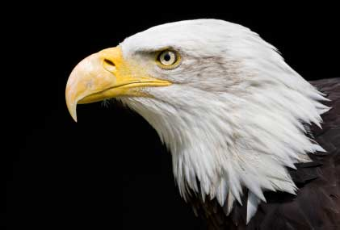
Nutrition and Digestive System
Bills
Used for feeding, preening, nest building, courtship displays, and defense
Eagle: modified for tearing
Cardinal: specialized for cracking seeds
Flamingo: modified to strain food from water

Slide 14
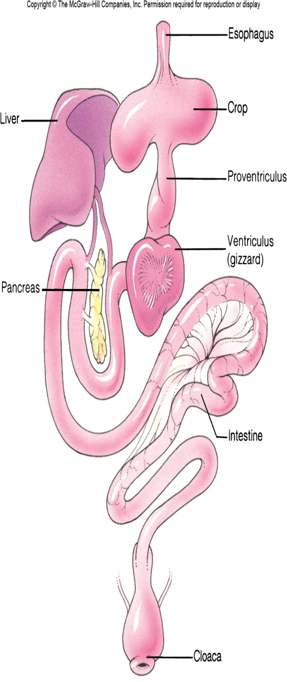
Nutrition and Digestive System
Crop
Storage structure
Allows quick ingestion of readily available food
Stomach (2 regions)
Proventriculus: secretes gastric juices to get digestion started
Ventriculus (gizzard): muscular walls
to crush hard materials.
Some birds may wallow rocks/sand to
aid in digestion.

Slide 15
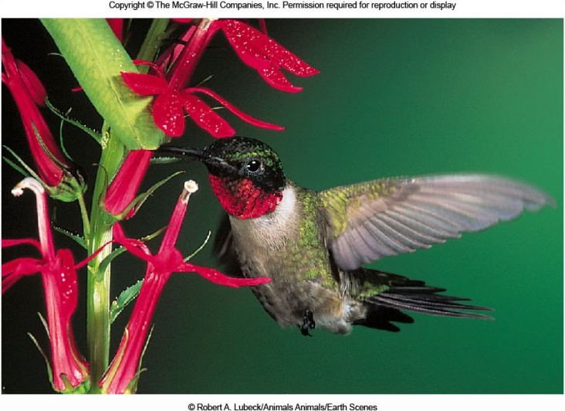
Circulation
Birds have a
Large heart
Rapid heart rate
Complete separation of oxygenated and deoxygenated blood.
All of these characteristics make endothermy and flight possible.

Slide 16
Gas Exchange
Complex and efficient
Voice box (syrinx): produce bird vocalizations
Two sets of air sacs:
1st inspiration: Air moves into abdominal air sacs, air already in lungs moves to thoracic air sacs.
1st expiration: Air in TAS moves out of bird and air in the AAS moves into the lungs
2nd inspiration: Air moves into TAS
2nd expirations: Air moves out of bird

Slide 17
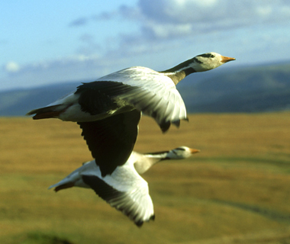
Gas Exchange
Because of high metabolic rates, birds have a greater rate of oxygen consumption that any other vertebrate.
Also allows them to fly at high altitudes where oxygen levels are low.
Fly at altitudes around 9200m during migration… humans feel altitude sickness at around 2500m.

Slide 18
Thermoregulation
Must maintain body temperatures between 100.4-113⁰F.
Lethal below 89.6⁰F or above 117 ⁰F.
Cold days
Fluff feathers
Tucks bill into feathers
Shivering
Increasing metabolism
Temperatures in the feet are allowed to reach freezing temperatures

Slide 19
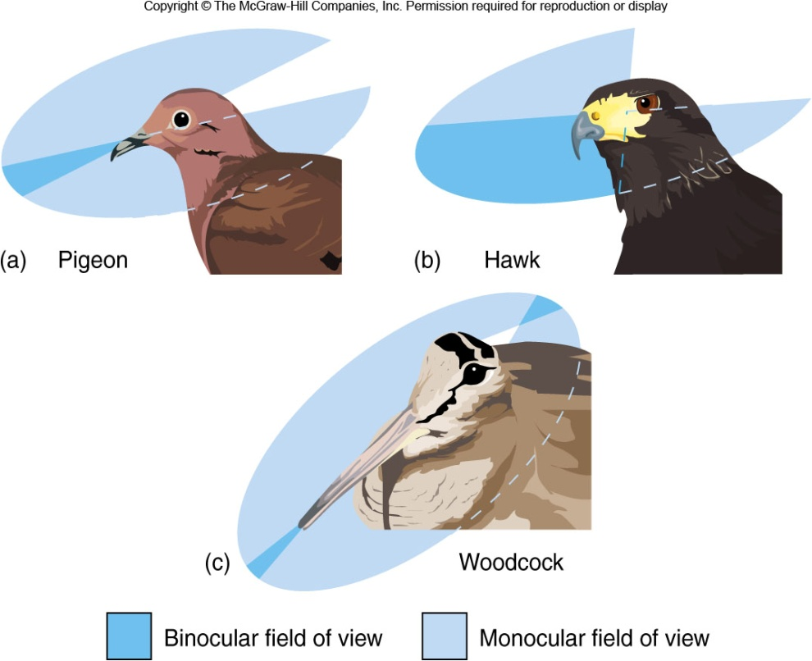
Nervous and Sensory Functions
A part of the brain called the corpus striatum is enlarged.
Responsible for feeding, visual learning, courtship and nesting.
Vision
Eyes are much larger (in relation to body size)
Can see using monocular and binocular vision (when depth perception is needed)

Slide 20
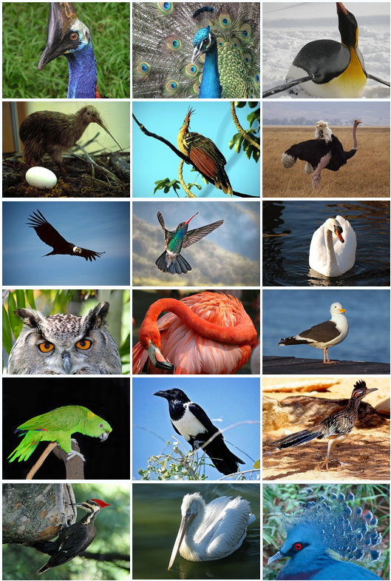
Nervous and Sensory Functions
Olfaction
Poorly developed
Exception: turkey vulture
Auditory
Well-developed hearing
Sensitivity is similar to humans

Slide 21
Excretion and Osmoregulation
Very similar to reptiles
Excrete uric acid from the cloaca (water is absorbed)
Salt glands
Get rid of excess salt
Extremely beneficial to birds that feed on invertebrates with large amounts of salt in tissues, or for birds that drink seawater

Slide 22
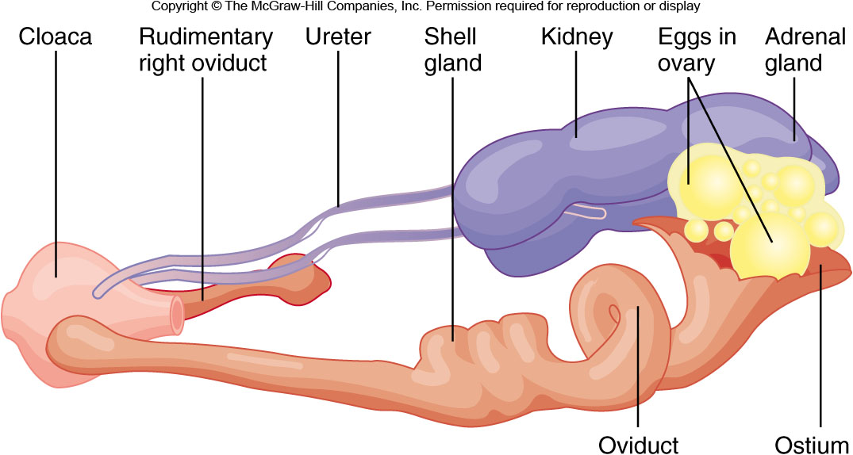
Reproduction and Development
Oviparous
Testes are paired and enlarge during the mating season.
Sperm is transferred by cloacal contact
Two ovaries form during development, but only the left forms completely.

Slide 23
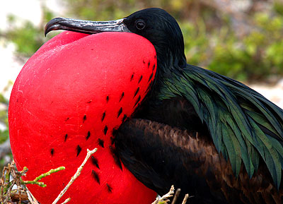
Reproduction and Development
Territories
Established prior to mating
Provide nest locations
Food resources
Mating and courtship
Varies between species
Songs, dances, drumming, posturing
Happens quickly and repeatedly to ensure eggs are fertilized
Monogamy

Slide 24
Reproduction and Development
Nesting and hatchlings
Most eggs are incubated (brood patch)
Eggs are rotated
Penetrates air sac, inflates lungs, begins breathing for a few days prior to hatching
Egg tooth cracks egg
Altricial
Hatchlings that are dependent upon hatching.
Parent will feed young and continue to brood them.
Precocial
Young are alert and lively
Can walk, run, swim and feed themselves
May still need help to find food.

Slide 25
Migration
Periodic round trips between breeding and nonbreeding areas.
Allows birds to avoid climate extremes and to secure adequate food, shelter, and space throughout the year.
Nesting in the north, wintering in the south.
Photoperiods and genetic clocks influence the preparation for migration.

Slide 26
Navigation
Two forms of navigation
Route-based: keeping track of landmarks
Location-based: use of sun compasses and Earth’s magnetic field

