Slide 1
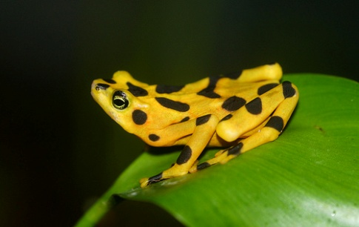
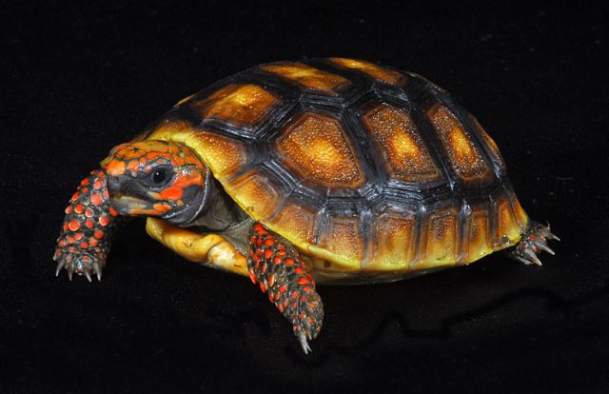
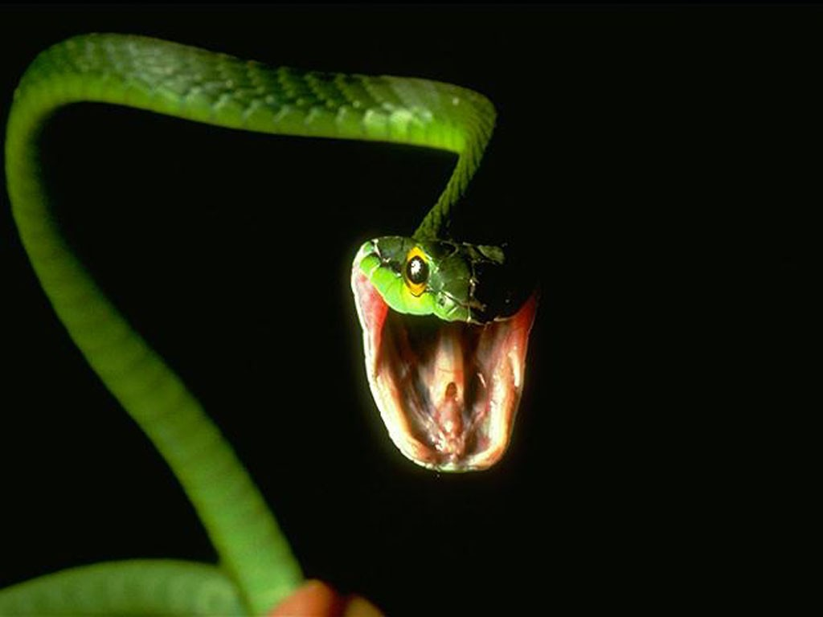
Amphibians and Reptiles

Slide 2
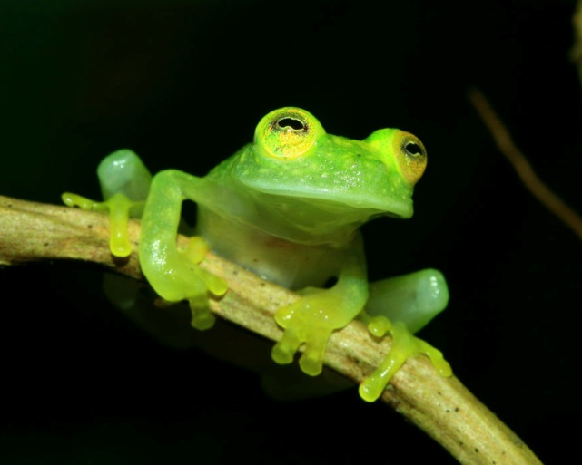
Class Amphibia
Amphibia=Double Life
Frogs, toads, salamanders, and caecilians
~6000 species
Skin with mucoid secretions, lack epidermal scales, feathers or hair
Larvae are usually aquatic and
undergo metamorphosis into
the adult stage.
Metamorphosis is controlled by
pituitary and thyroid glands

Slide 3
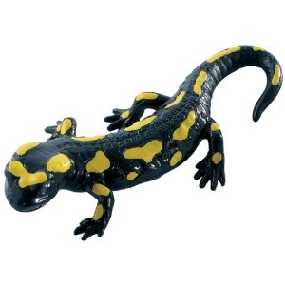
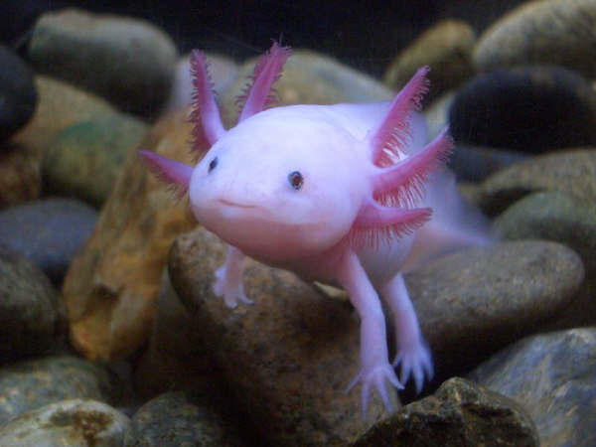
Order Caudata
Salamanders
Live in moist areas (forest floor/caves)
Aquatic larvae
Internal fertilization
Spermatophore
Eggs deposited in clumps/strings
Usually metamorphosize into adults
Some will retain larvae characteristics (mudpuppies)
Others will undergo metamorphosis only when conditions become unfavorable.

Slide 4
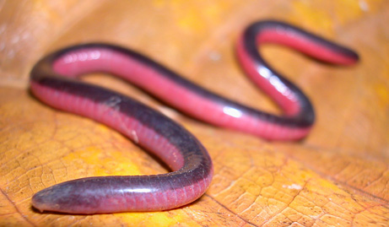
Order Gymnophiona
Caecilians
~160 species
Most burrow in the soil and feed on worms
Internal fertilization
Larvae stages are in oviduct, where they scrape with fetal teeth to feed.
Young emerge as mini-adults
Others lay eggs
Notes:
Skin covers the eyes…so probably blind

Slide 5
Order Anura
Frogs and Toads
~4000 species
Most live in moist environments
Adults lack tails
Very muscular hindlimbs with webbed feet
External fertilization
Egg and larvae are in aquatic environments
Larvae: long tails, lack limbs, herbivores
Notes:
Some found in deserts

Slide 6
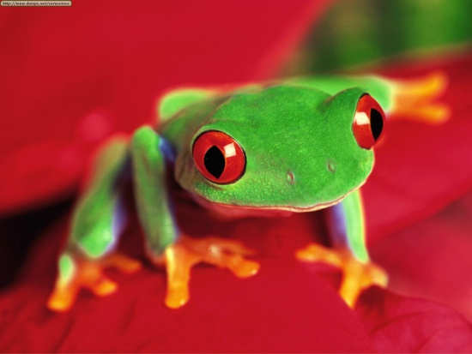
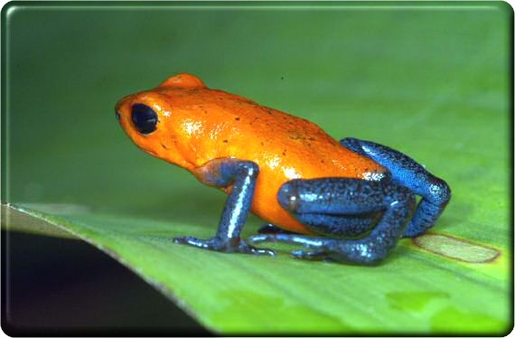
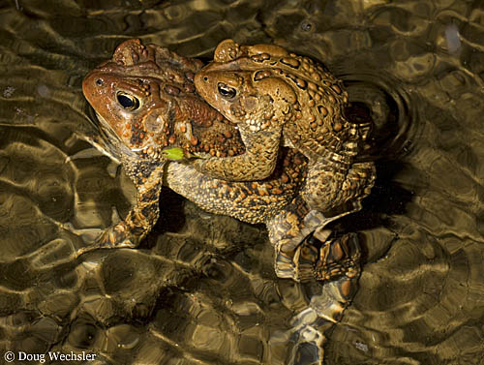
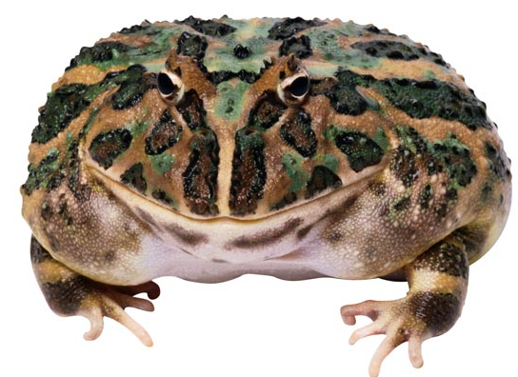
Toad vs. Frog
Toad
Dry, warty skin
More terrestrial
Frogs
Smoother skin
Prefer aquatic habitats

Slide 7
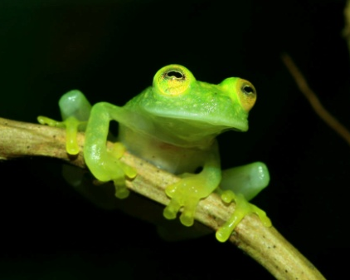
External Structure
Lacks a covering of scales, feathers or hair
Highly glandular
Secretions aid in protection and produce toxic chemicals to discourage predators
Keep skin moist to prevent drying
Produce sticky secretions to help male grasp female during mating
Chromatophores in skin for coloration
Notes:
Some release neurotoxins, myotoxic, antibacterial, and antifungal effects of glands

Slide 8
Locomotion
Skeleton is modified (from fishes) to support the pull of gravity
Skull is flattened, smaller and fewer bony elements
Changes in jaw structure allow for crushing prey
Cervical vertebrae and Pelvic girdle
Salamander/alternating style
Caecilians/accordian-like
Frogs/Toads powerful jumping

Slide 9
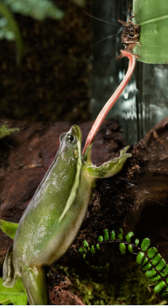
Nutrition and Digestive System
Adults: carnivores
Mainly small invertebrates
Some will feed on small mammals, birds, or other amphibians
Larvae: herbivores
Anurans flick their tongue that has
sticky secretions on it to capture prey
Food is pushed to the back of the
mouth and swallowed (eyes sink downward
to aid in swallowing)
Notes:
Most locate by sight, salamanders and caecilians use olfaction

Slide 10
Circulation, Gas Exchange, and Temperature Regulation
Gas exchange can take place across the skin, via the lungs, and/or gills
Cutaneous Respiration
Allows for gas exchange to take place across the skin.
Salamanders use this for their primary source for oxygen
Allows frogs to spend winter in
bottom of ponds

Slide 11
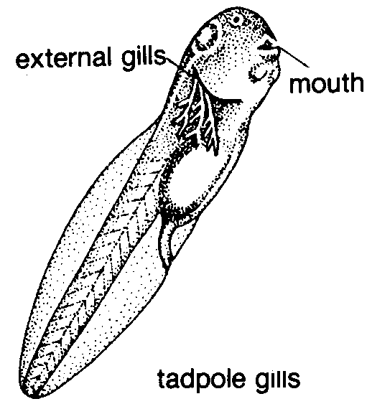
Circulation, Gas Exchange, and Temperature Regulation
Lungs
Used in adult frogs (salamanders have simple sacs that are rarely used)
Temperature has an effect on use
Gills
Larvae and some adults rely on
gills for gas exchange

Slide 12
Circulation, Gas Exchange, and Temperature Regulation
Ectothermic
In water, body temperatures are the same as the water.
On land, body temps are different from environment
Regulation is behavioral
Nocturnal, under leaf-litter
Basking in sun (common after a
meal)

Slide 13
Nervous and Sensory Functions
Sensory structures on skin
Respond to heat, cold, and pain
Lateral line system
Respond to low-frequency vibrations (more important to aquatic stages of life)
Chemoreception
Olfaction
mate recognition
detecting chemicals
locating food

Slide 14
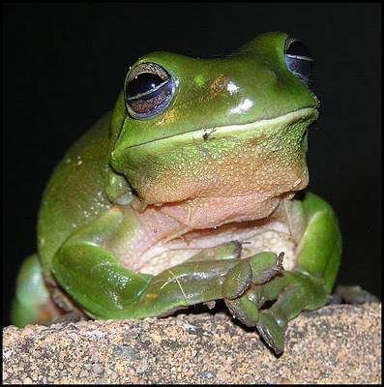
Nervous and Sensory Functions
Vision
Sight feeders
Eyes are on front of head
Binocular vision
Depth perception
Nictitating membrane
Transparent eyelid, covers cornea

Slide 15
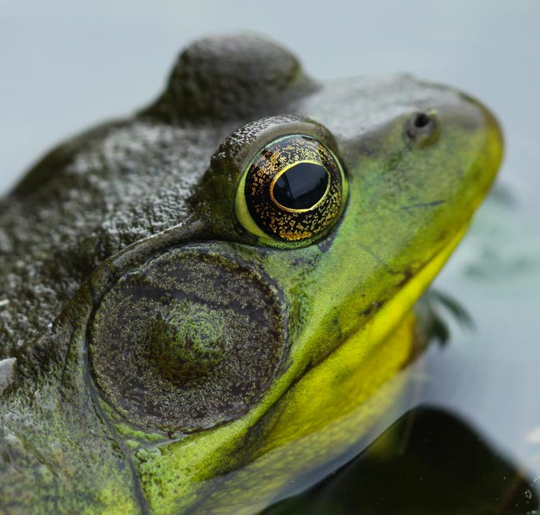
Nervous and Sensory Functions
Auditory system
Tympanic membrane
Receives airborne vibrations and transmits them to inner ear
High-frequency transmissions (used during mating season)
Inner ear and 2nd ossicles (operculum)
Low-frequency transmissions
Warn of approaching predators

Slide 16
Excretion
Freshwater amphibians excrete ammonia
No energy expenditure, diffuses into H20
Terrestrial amphibians excrete urea
Produced from Urea in the liver
Uses large quantities of water for excretion
Can be stored in bladder

Slide 17
Reproduction, Development, and Metamorphosis
Dioecious
External Fertilization (except caecilians/salamanders)
Development is tied to moist environments because eggs lack resistant coverings
Temperature regulates breeding seasons (spring and summer)
Tropical environments
rainy seasons

Slide 18
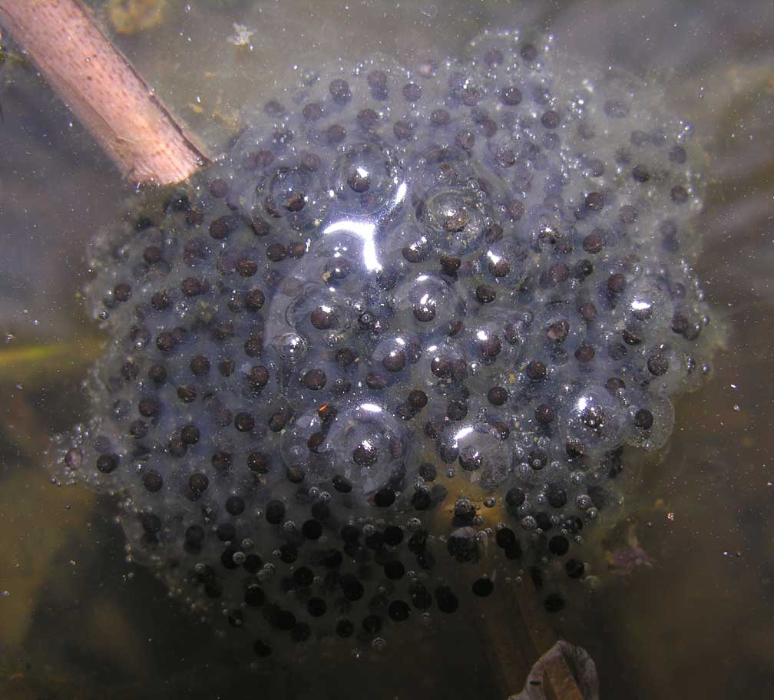
Reproduction, Development, and Metamorphosis
Courtship behaviors
Salamanders
Olfactory and visual cues
Toads/frogs
Male vocalizations (species specific)
Attract the mates
Tactile cues
Males grasps female (called amplexus)
Male releases sperm, female releases eggs
Notes:
Locate breeding sites, identify potential mates

Slide 19
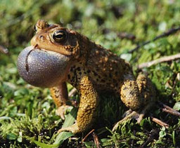
Vocalization
Advertisement calls
Attract females to breeding areas
Mark territories
Release calls
Inform a partner that a frog is incapable of breeding (unresponsive females, mistaken males)
Distress calls
Response to pain or predation
May even scare away the predator

Slide 20
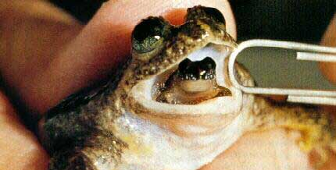
Parental Care
Requires large energy expenditures
Most often is by attending the clutch (eggs)
Salamanders/Caecilians
Females
Frogs/Toads
Males
Aeration of eggs, cleaning/moistening terrestrial eggs, protection, removal of dead eggs

Slide 21
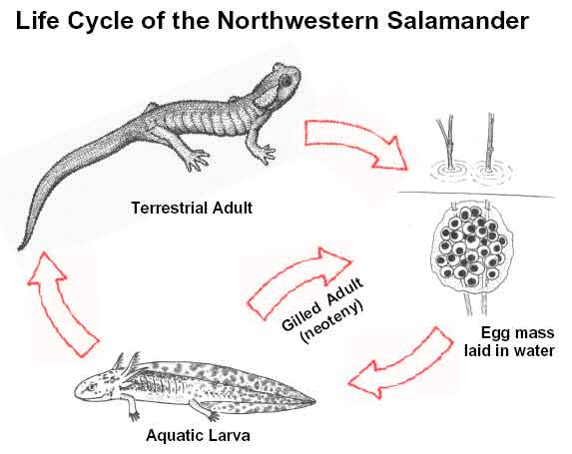
Metamorphosis
Series of abrupt structural, physiological, and behavioral changes that transform a larva into an adult
Hypothalamus, pituitary gland, and the thyroid gland control metamorphosis
Caecilians/Salamanders
Reproductive structures develop
Gills are lost
Caudal fin is lost

Slide 22
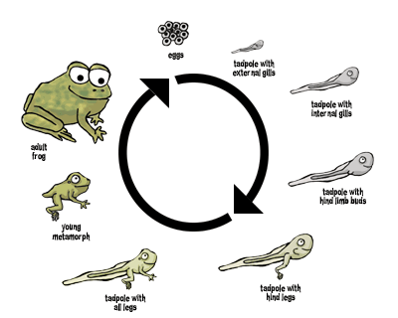
Metamorphosis
Frogs/Toads
Limbs and lungs develop
Tail is reabsorbed
Skin thickens
Head and digestive tract are modified (different food source)

Slide 23
Amphibians in Peril
Sensitive to environmental changes
Thin permeable skin
Water and airborne pollutants can penetrate it easily
Developmental stages that require aquatic environments could be harmed
Clear cutting forests (allows sunlight to dry up forest floor)
Destroying habitats
Fungal infections that cause hardening of the skin

Slide 24
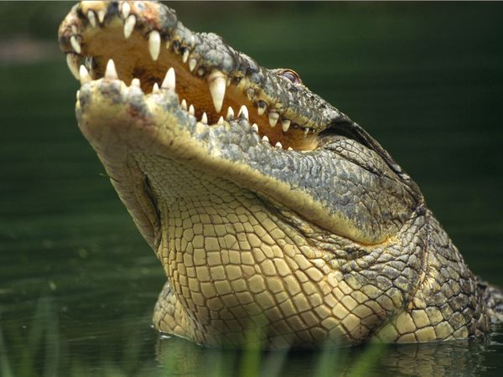
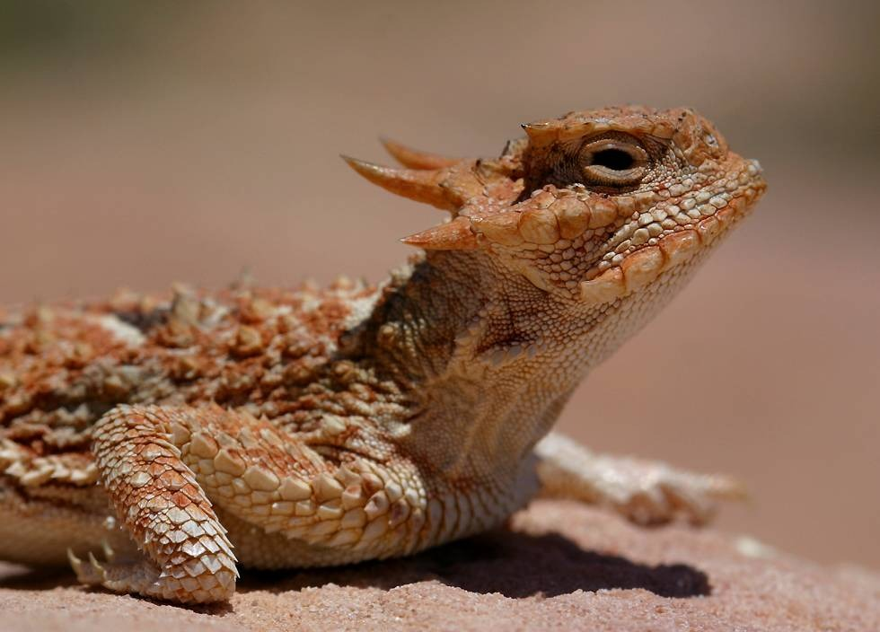
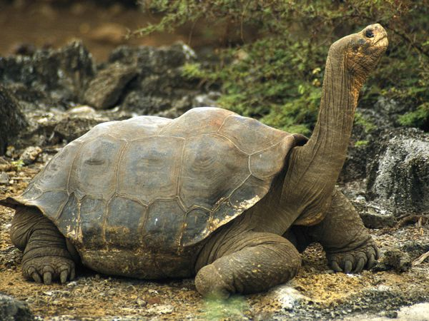
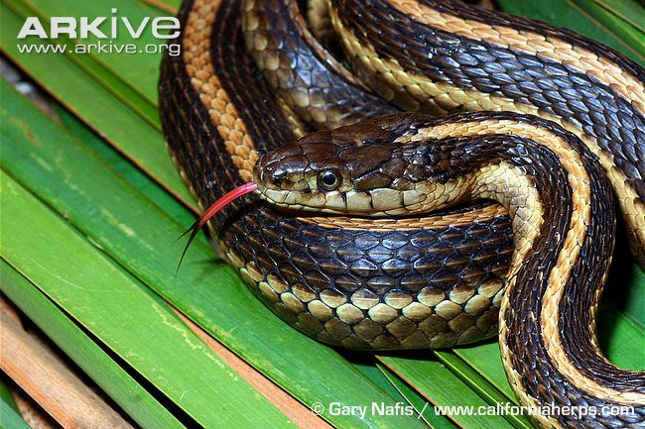
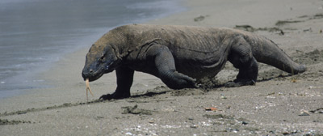
Reptiles
Dry skin with scales
Respiration via lungs
Internal fertilization
Amniotic eggs

Slide 25
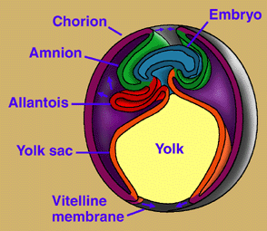
Life on land
Amniotic egg
Extraembryonic membranes that protect the embryo from
Desiccation
Cushion the embryo
Promote gas transfer
Store waste materials
Birds and reptiles also have
Leathery or hard shells to protect the embryo
Albumen provides moisture and nutrients
Yolk that supplies food to the embryo

Slide 26
Please note…according to cladistics, birds and reptiles should be in the same lineage. Your book refers to birds as avian reptiles.
We are covering reptiles and amphibians together so that you can see the major differences between body morphology and characteristics from life in the water and on land.

Slide 27
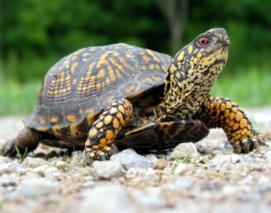
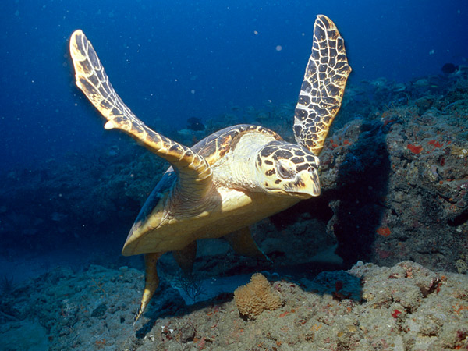
Order Testudines
Turtles (~300 species)
Bony shell
Keratinized beak (instead of teeth)
Shell
Carapace (dorsal)
Plastron (ventral)
Both are covered with keratin

Slide 28
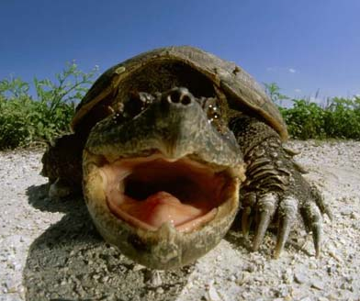
Order Testudines
Some shells have hinges that allow them to close completely
Turtles have 8 cervical vertebrae that can be articulated into an S shape which allows the head to be drawn into the shell
Long life spans
Sexual maturity 7-8 years
Live 14+ years
Some tortoises can live 100+ yrs
Lack webbing on feet and entirely terrestrial

Slide 29
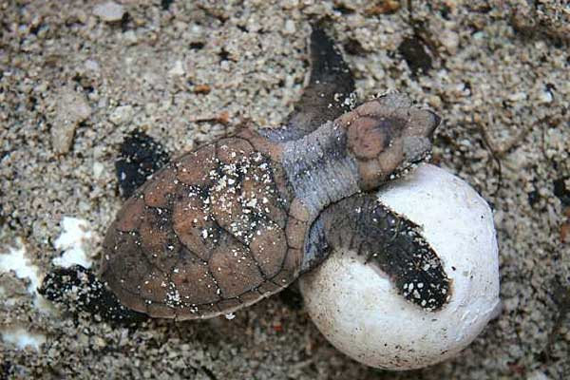
Order Testudines
Oviparous
Females dig nests in ground
5-100 eggs
4 weeks to one year
Young are independent at the time of hatching

Slide 30
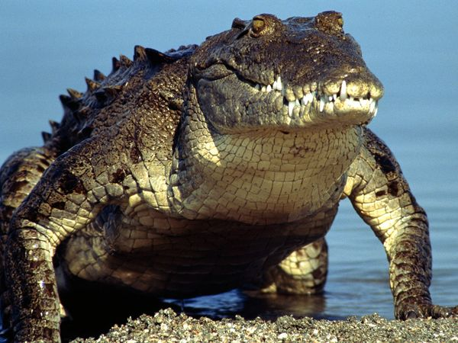
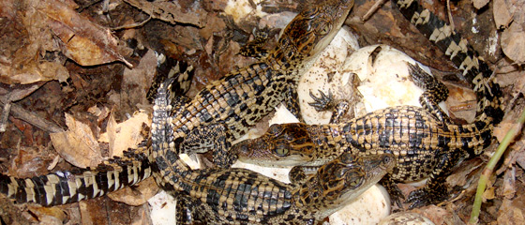
Order Crocodylia
Crocodiles, alligators, and caimans (~21 species)
Elongated snout, sideways sweep of head (capture food)
Nostrils at the tip of the snout (breathe while submerged)
Tail is used for swimming, offensive and defensive maneuvers and attacking prey
Food
Swallowed whole
Can grab onto prey and roll with it to rip apart
Swallow rocks to help in breaking down food
Oviparous and show nesting/parental care

Slide 31
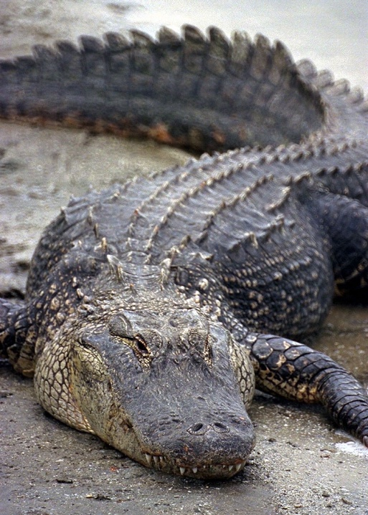
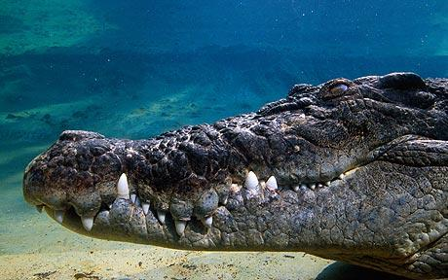
Crocodile vs. Alligator
Crocodile
North, Central and South America, Africa, Southeast Asia, and Australia
Long, V-shaped snout
4th tooth sticks up over the lip
Saltwater
Alligator
Southern US and eastern China
Wide, U-shaped jaw
4th tooth is under the lip
Freshwater

Slide 32
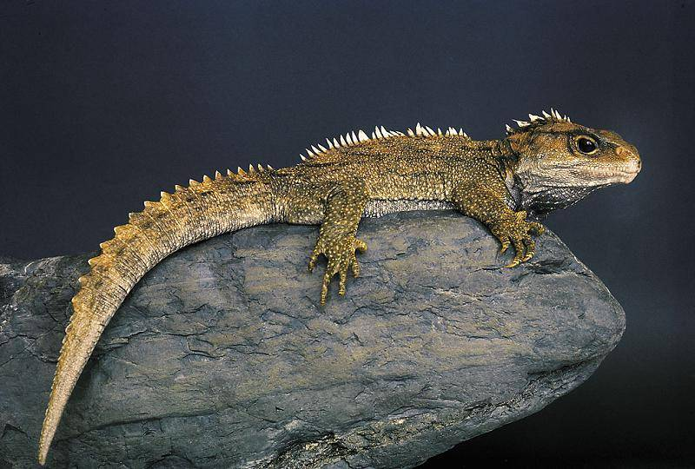
Order Sphenodontida
Tuataras (2 species)
Lizard-like
Two rows of teeth on upper jaw and a single row of teeth on the lower jaw can decapitate a small bird!
Found in New Zealand
Oviparous and use sea-nesting birds’ underground burrows.

Slide 33
Order Squamata
Lizards and Snakes
Suborder Sauria (~4500 species)
Lizards
2 pairs of legs
Jaws unite
Most are oviparous, but some can be ovoviviparous or viviparous
Geckos, Iguanas, Chameleons

Slide 34
Suborder Serpentes…the Snakes!
~2900 species (300 species of those are venomous)
Elongate
Lack limbs (vestigial pelvic girdles and appendages are present in pythons and boas)
Skeleton may contain more than 200 vertebrae and pairs of ribs
Joints between vertebrae make the body very flexible
Notes:
30,000 people die from snake bites each year, most are in SE Asia
IN the US 9-15 die each year, because of the availability of emergency healthcare

Slide 35
Suborder Serpentes…the Snakes!
Skull adaptations for swallowing large prey
Upper jaws that are movable
Upper and lower jaws that are loosely joined so that they can move independently
Elongation and narrowing of the body…
Loss of the left lung
Displacement of the gallbladder and
right kidney and often the gonads
Most are oviparous
Notes:
Boas, vipers, and cobras give birth to live young!

Slide 36
External Structure and Locomotion
Skin has NO respiratory functions
Skin is thick, dry, and keratinized
Scales
All will periodically shed the outer layer of skin through ecdysis
Chromatophores
Notes:
Blood supply to the skin does not extend into the epidermis, the outer epidermal cells lose contact with the blood supply and die.

Slide 37
Support and Movement
Secondary palate
Separates the nasal passages from the mouth.
Allows organisms to breath while chewing
Autotomy
Tail loss, caudal vertebrae are broken
Escape mechanism
Locomotion
Body is slung low, appendages
move in the horizontal plane

Slide 38
Nutrition and the Digestive System
Carnivores
Tongues
Nonprotusible (turtles and crocodilians), aid in swallowing
Sticky secretions on tongue that aid in capturing prey (chameleons, lizards, and tuatara)

Slide 39
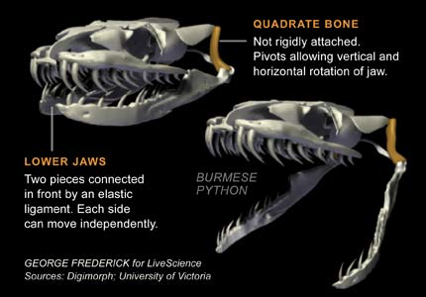
Nutrition and the Digestive System
Skull
Snakes the bones are loosely joined so they can spread apart while eating.
Teeth point backwards
to prevent the prey from
escaping.
Respiratory opening is far
forward in mouth so it can
take its time swallowing prey and still breath.

Slide 40
Circulation, Gas Exchange and Temperature Regulation
Circulation is very similar to amphibians
Lungs are expanded and compressed by movements of the ribs and body wall.
Ectotherms…use external heat sources for thermoregulation (77-98.6⁰F)
Notes:
Nocturnal, rocks…positioning body away or towards the sun.
Physiological: panting, releases heat. Divert blood to skin…to warm up in sun. Reduce heart rate and flow of blood to skin, reduces cooling. Torpor: Use each others body heat to overwinter….some may still freeze to death.

Slide 41
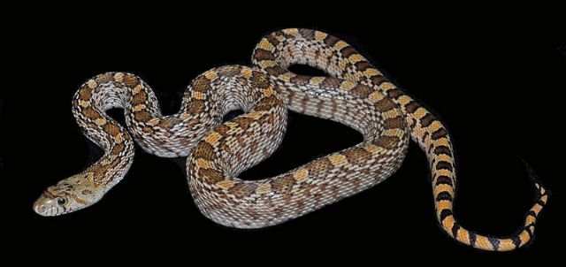
Nervous and Sensory Functions
Brains are a bit larger than amphibians, it is believed that this is due to improved sense of smell.
Vision
Chameleons: eyes work independently, but when prey is spotted images form one (binocular vision)
Color vision
Nictitating membrane
Some have spectacle (clear protective window of skin
Sense vibrations

Slide 42
Nervous and Sensory Functions
Jacobson’s organs
Pouches used for olfaction
Best developed in snakes, tongue flicks out and then is put back into mouth for chemical recognition
Rattlesnakes and pit vipers have pit organs that sense changes in temperature in their surroundings.
Believed that sea turtles use the
Earth’s magnetic field.

Slide 43
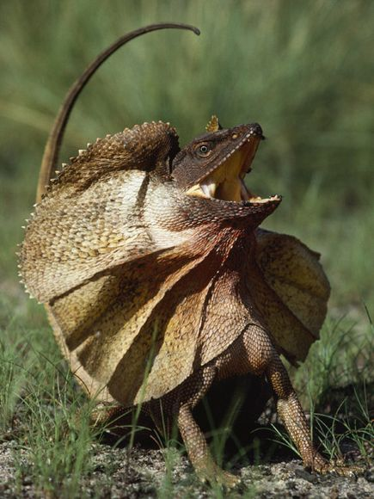
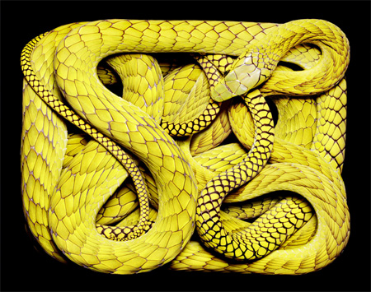
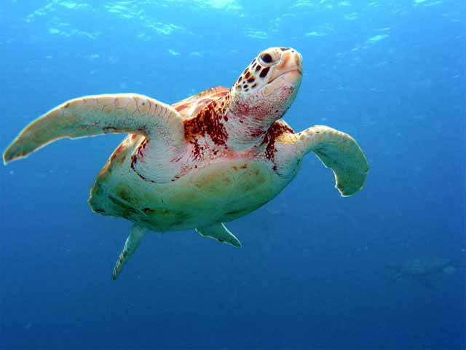
Excretion and Osmoregulation
Life on land, increased body size, and higher metabolic rates require kidneys capable of processing wastes with little water loss.
Metanephric kidneys
Excrete uric acid
Non-toxic, paste-like (prevents excess water loss)

Slide 44
Reproduction and Development
Amniotic eggs
Significant energy expenditures
Internal fertilization
Fertilization must occur in the reproductive tract before the protective membranes around the egg are developed.
Sperm is transferred and stored in seminal receptacle. Can be stored for up to 6 years in some snakes!!!
Parthenogenesis has been described in some lizards and snakes

Slide 45
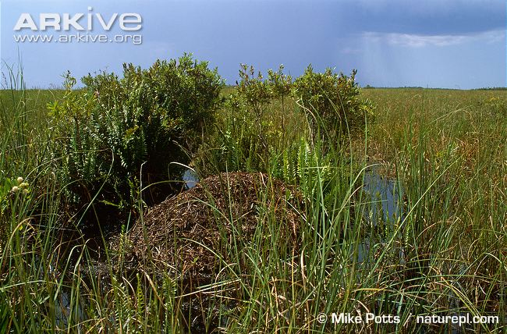
Reproductive Behaviors
Some males seek out females
Head-bobbing (reveals bright patches of skin)
Tail-waving, entwining body around female snake
Release sex pheromones
Vocalizations in crocodiles
Males are hostile (bark or cough)
Eggs are abandoned, covered,
or hidden
Temperatures affect sex of
hatchlings

